Slide 1

وحید امیری
کارشناس ارشد فناوری اطلاعات - تجارت الکترونیک
کارشناس و مشاور در حوزه کلان داده
VahidAmiry.ir
@vahidamiry
پایگاه داده‌های غیررابطه‌ایی

Slide 2
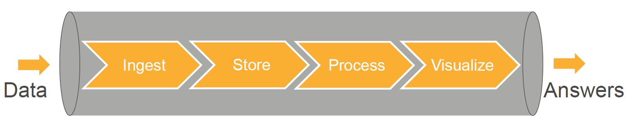
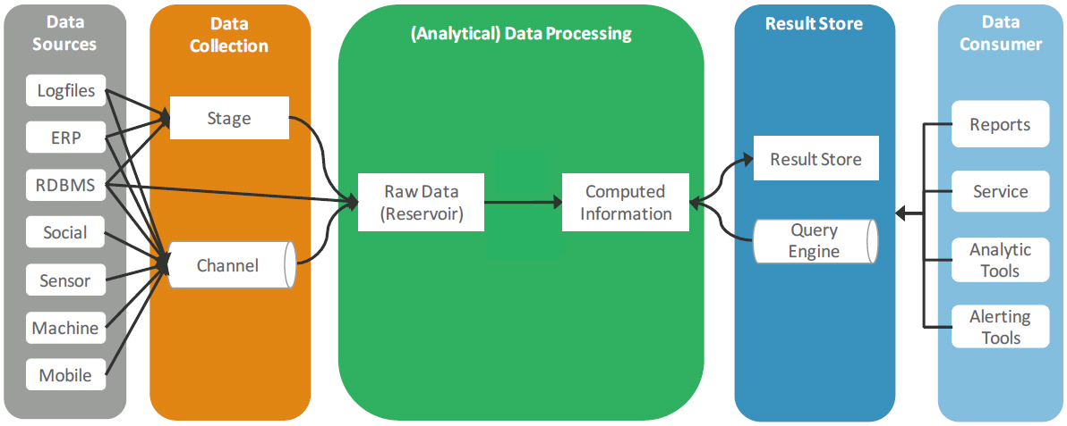
Big Data Pipeline
Simplified Big Data Pipeline

Slide 3




Data Ingestion
Scalable, Extensible to capture streaming and batch data
Provide capability to business logic, filters, validation, data quality, routing, etc. business requirements
Technology Stack:
  Apache Flume
  Apache Kafka
  Apache Sqoop
  Apache NiFi

Slide 4



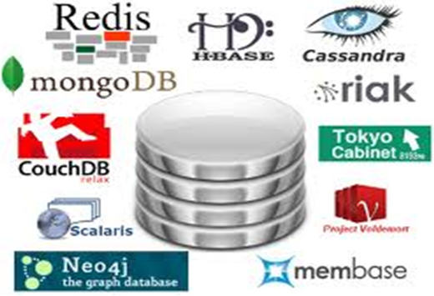
Data Storage
Depending on the requirements data can placed into Distributed File System, Object Storage, Nosql Databases, etc.
Metadata Management
Policy-based data retention is provided
Technology Stack
  HDFS/ Hive
  Redis/Mongodb/Hbase/Cassandra/ElasticSearch
  …

Slide 5





Data Processing
Processing is provided for batch, streaming and near-realtime use cases
Scale-Out Instead of Scale-Up
Fault-Tolerant methods
Process is moved to data
Technology Stack
  Mapreduce
  Spark
  Storm
  Flink

Slide 6




Visualization and APIs
Dashboard and applications that provides valuable bisuness insights
Data can be made available to consumers using API, messaging queue or DB access
Technology Stack
  Qlik/Tableau/Spotifire
  REST APIs
  Kafka
  JDBC

Slide 7















Big Data Architecture

Slide 8
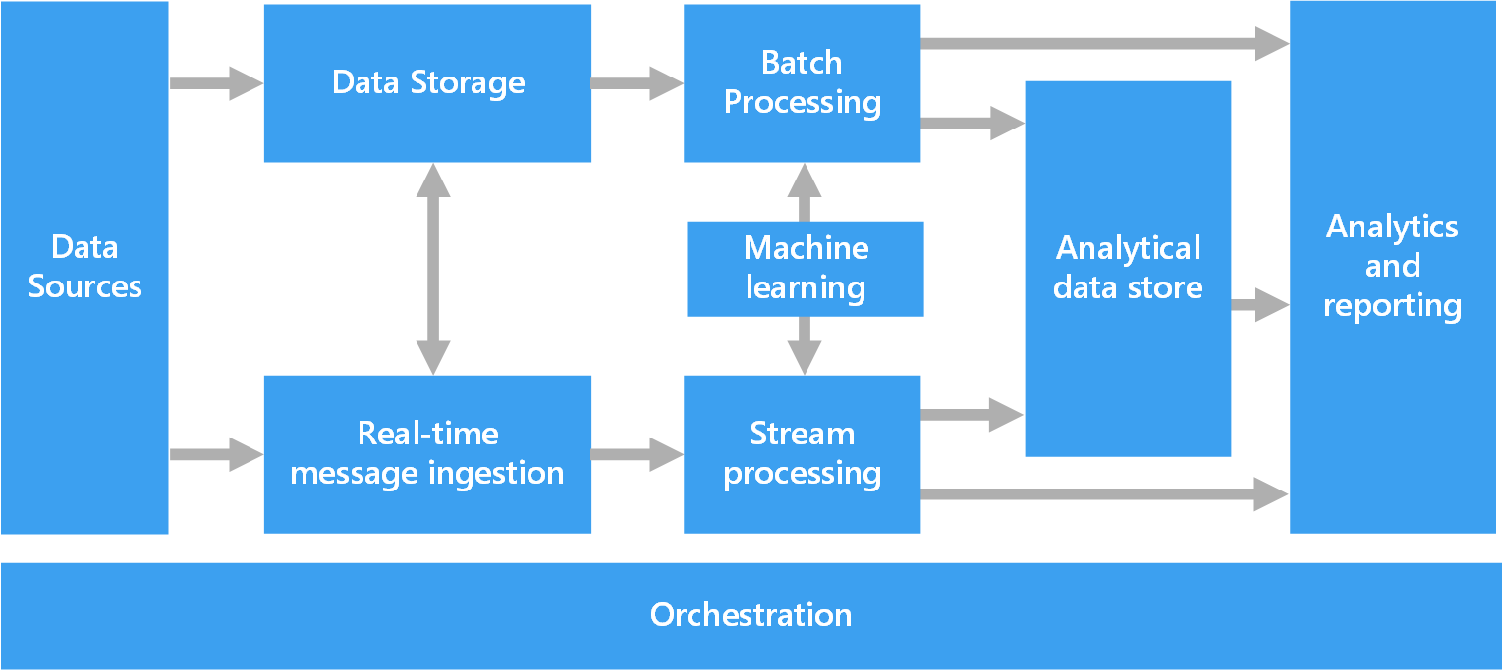
Big Data Architecture

Slide 9
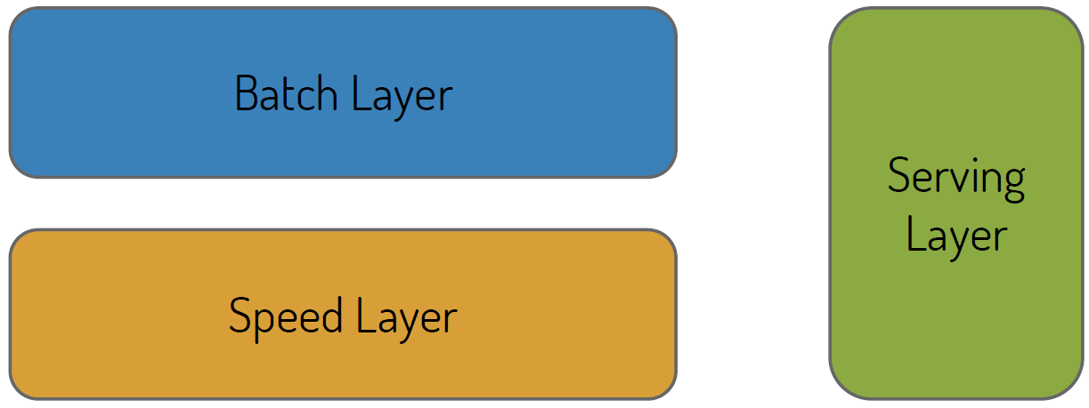
Lambda Architecture
A data-processing architecture designed to handle massive quantities of data by taking advantage of both batch and stream processing methods.
I need fast access to historical data on the fly for predictive modeling with real time data from the stream

Slide 10
Lambda Architecture
All data is sent to both the batch and speed layer
Master data set is an immutable, append-only set of data
Batch layer pre-computes query functions from scratch, result is called Batch Views. Batch layer constantly re-computes the batch views.
Batch views are indexed and stored in a scalable database to get particular values very quickly. Swaps in new batch views when they are available
Speed layer compensates for the high latency of updates to the Batch Views
Uses fast incremental algorithms and read/write databases to produce realtime views
Queries are resolved by getting results from both batch and real-time views

Slide 11
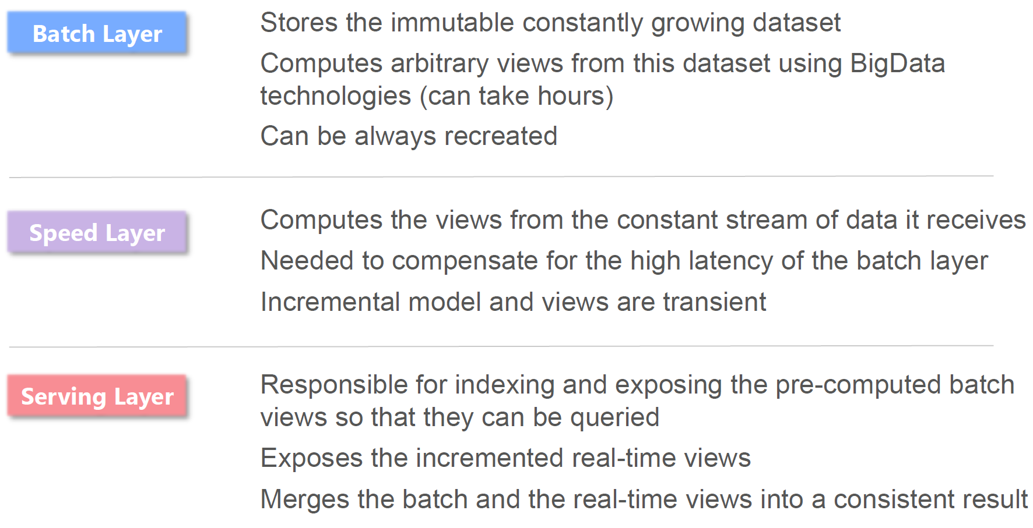
Lambda Architecture

Slide 12
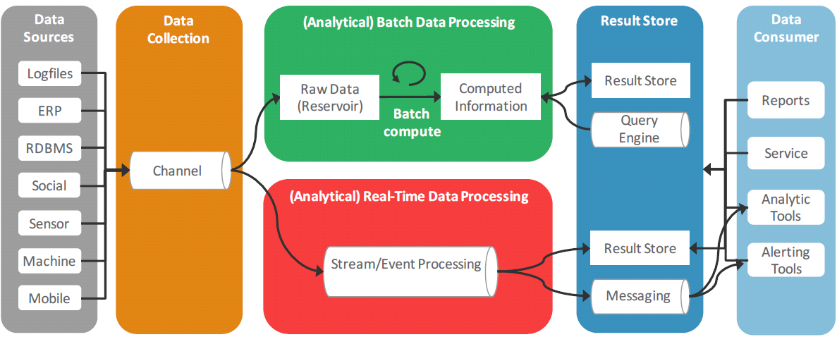
Lambda Architecture

Slide 13
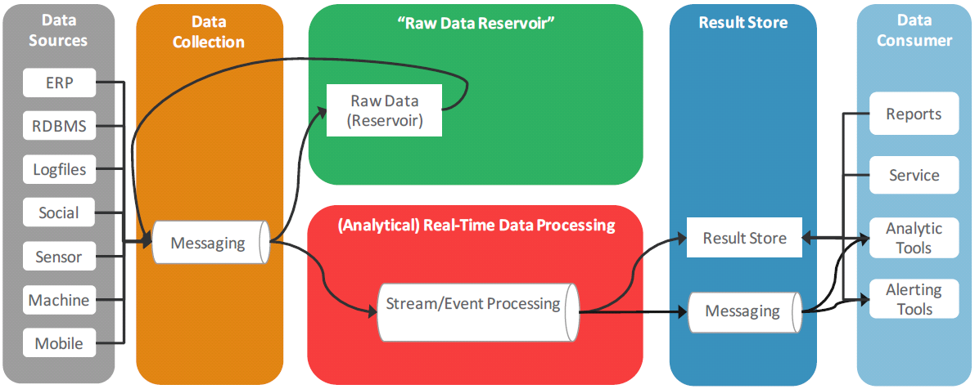
Kappa Architecture

Slide 14
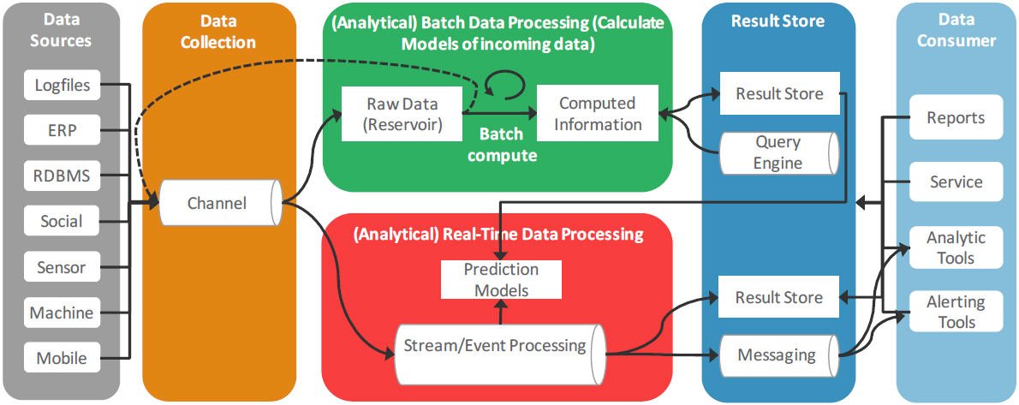

Unified Architecture

Slide 15

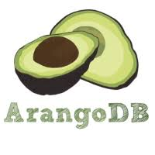





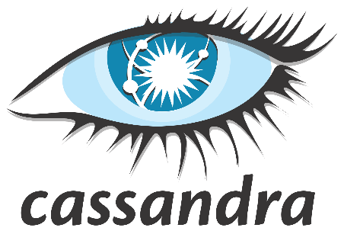

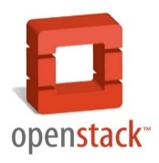

Slide 16
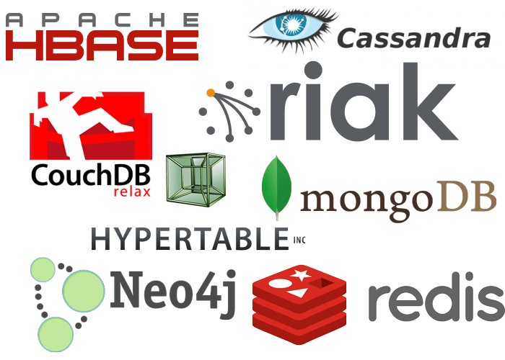
NOSQL Databases

Slide 17
Nosql
Relational database (RDBMS) technology
  Has not fundamentally changed in over 40 years
  Default choice for holding data behind many web apps
  Handling more users means adding a bigger server
Extend the Scope of RDBMS
  Caching
  Master/Slave
  Table Partitioning
  Federated Tables
  Sharding

Slide 18
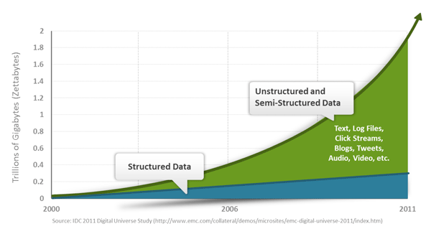
Something Changed!
Organizations work with different type of data, often semi or un-structured.
And they have to store, serve and process huge amount of data.
There were a need for systems that could:
  work with different kind of data format,
  Do not require strict schema,
  and are easily scalable.

Slide 19
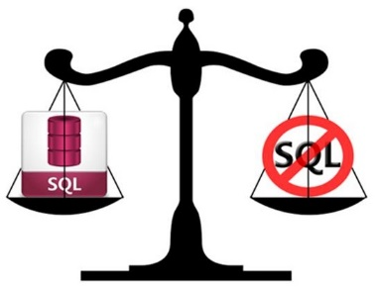
RDBMS with Extended Functionality
Vs.
Systems Built from Scratch with Scalability in Mind

Slide 20
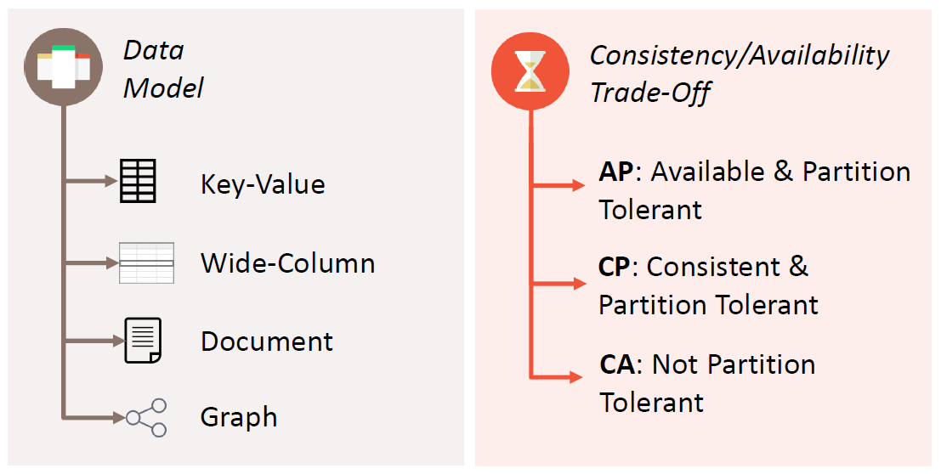
Nosql System Classification
Tow common criteria:

Slide 21
Evolutions in Data Management
As part of innovation in data management system, several new technologies where built:
  2003 - Google File System,
  2004 - MapReduce,
  2006 - BigTable,
  2007 - Amazon DynamoDB
  2012 Google Cloud Engine
Each solved different use cases and had a different set of assumptions.
All these mark the beginning of a different way of thinking about data management.

Slide 22
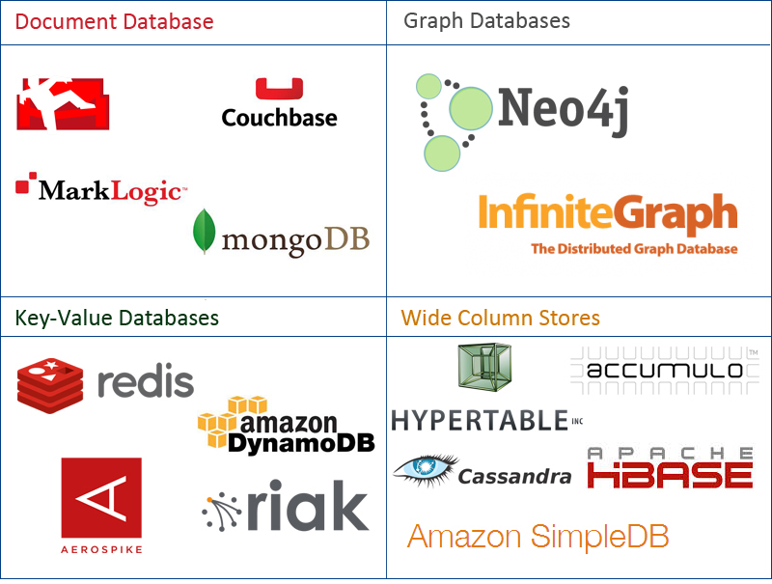
Nosql Data Model

Slide 23
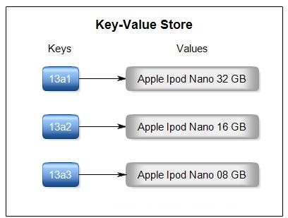
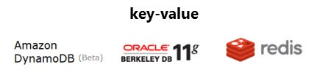
Key Value Store
Extremely simple interface:
  Data model: (key, value) pairs
  Basic Operations: : Insert(key, value), Fetch(key), Update(key), Delete(key)
Pros:
  very fast
  very scalable
  simple model
  able to distribute horizontally
Cons:
  many data structures (objects) can't be easily modeled as key value pairs

Slide 24
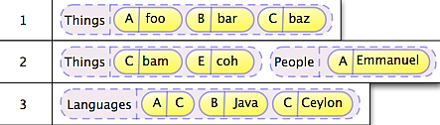
Column Oriented Store

Slide 25
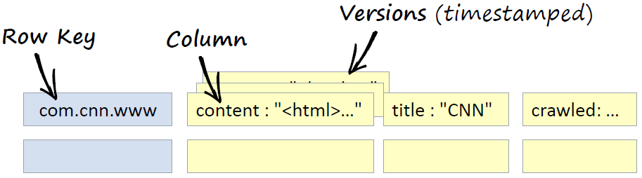
Column-oriented
Store data in columnar format
Allow key-value pairs to be stored (and retrieved on key) in a massively parallel system
  data model: families of attributes defined in a schema, new attributes can be added online
  storing principle: big hashed distributed tables
  properties: partitioning (horizontally and/or vertically), high availability etc. completely transparent to application
Column Oriented Store
  BigTable
  Hbase
  Hypertable
  Cassandra

Slide 26
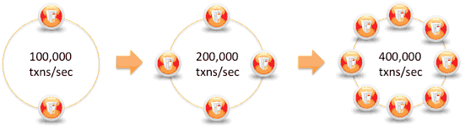
Cassandra
All nodes are similar
Data can have expiration (set on INSERT)
Map/reduce possible with Apache Hadoop
Rich Data Model (columns, composites, counters, secondary indexes, map, set, list, counters)

Slide 27

Document Store

Slide 28
Document Store
Schema Free.
Usually JSON (BSON) like interchange model, which supports lists, maps, dates, Boolean with nesting
Query Model: JavaScript or custom.
Aggregations: Map/Reduce.
Indexes are done via B-Trees.
Examples:
  MongoDB
  CouchDB
  CouchBase
  RethinkDB

Slide 29
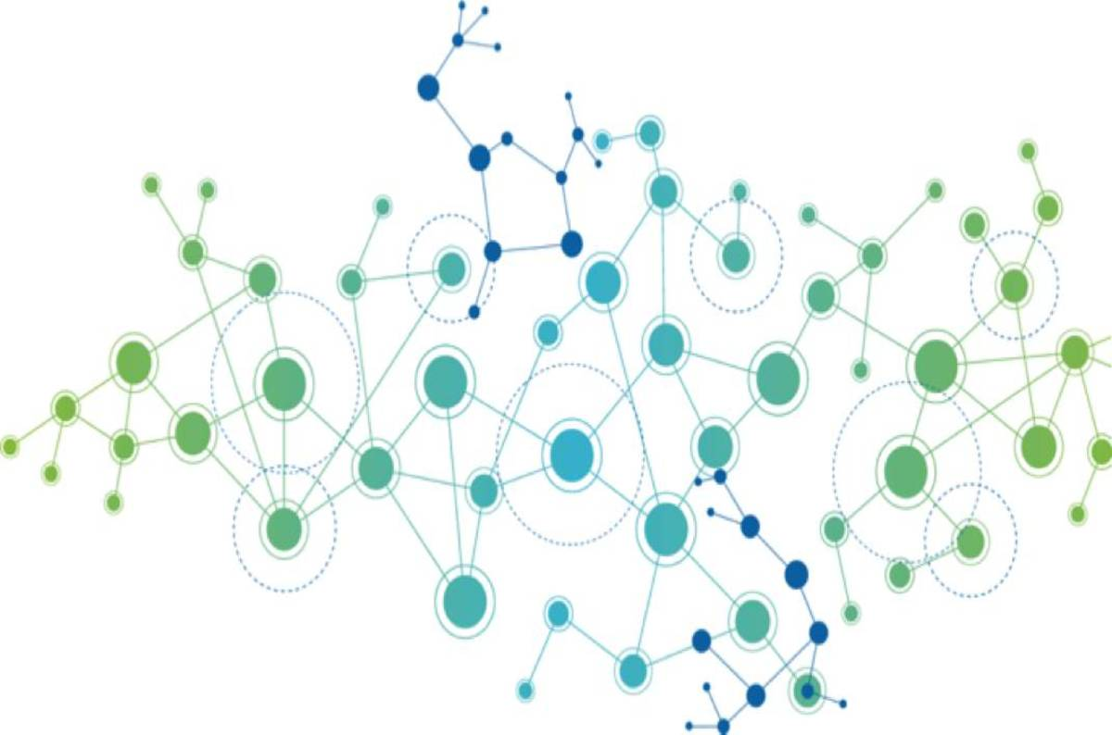
Graph Databases

Slide 30
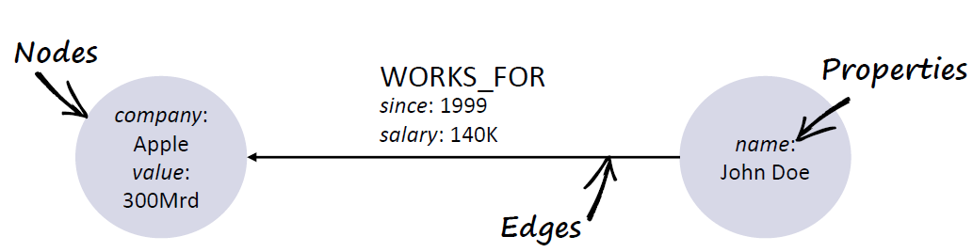
Graph Databases
They are significantly different from the other three classes of NoSQL databases.
Are based on the concepts of Vertex and Edges
Relational DBs can model graphs, but it is expensive.
Graph Store
  Neo4j
  Titan
  OrientDB

Slide 31
Neo4j
A highly scalable open source graph database
Neo4j provides a fully equipped, well designed and documented rest interface
Neo4j is the most popular graph database in use today.
License AGPLv3/Commercial

Slide 32
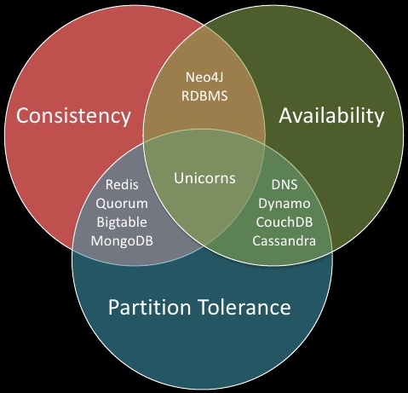
Nosql Implementation Considerations

Slide 33
CAP Theorem
Conjectured by Prof. Eric Brewer at PODC (Principle of Distributed Computing) 2000 keynote talk
Described the trade-offs involved in distributed system
It is impossible for a web service to provide following three guarantees at the same time:
  Consistency
  Availability
  Partition-tolerance

Slide 34
CAP Theorem
C
A
P
Consistency:
  All nodes should see the same data at the same time
Availability:
  Node failures do not prevent survivors from continuing to operate
Partition-tolerance:
  The system continues to operate despite network partitions
A distributed system can satisfy any two of these guarantees at the same time but not all three

Slide 35
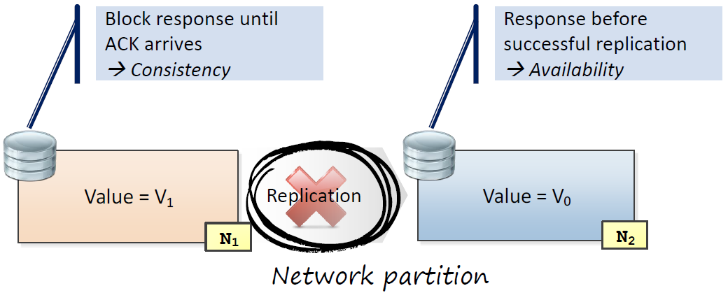
CAP-Theorem: simplified proof
Problem: when a network partition occurs, either consistency or availability have to be given up

Slide 36
Problem for Relational Database to Scale
The Relational Database is built on the principle of ACID (Atomicity, Consistency, Isolation, Durability)
It implies that a truly distributed relational database should have availability, consistency and partition tolerance.
Which unfortunately is impossible …

Slide 37
Revisit CAP Theorem
Of the following three guarantees potentially offered a by distributed systems:
  Consistency
  Availability
  Partition tolerance
Pick two
This suggests there are three kinds of distributed systems:
  CP
  AP
  CA
C
A
P
Any problems?

Slide 38
A popular misconception: 2 out 3
How about CA?
Can a distributed system (with unreliable network) really be not tolerant of partitions?
C
A

Slide 39
CAP Theorem 12 year later
Prof. Eric Brewer: father of CAP theorem
  “The “2 of 3” formulation was always misleading because it tended to oversimplify the tensions among properties. ...
  CAP prohibits only a tiny part of the design space: perfect availability and consistency in the presence of partitions, which are rare.”
http://www.infoq.com/articles/cap-twelve-years-later-how-the-rules-have-changed

Slide 40
Consistency or Availability
Consistency and Availability is not “binary” decision
AP systems relax consistency in favor of availability – but are not inconsistent
CP systems sacrifice availability for consistency- but are not unavailable
This suggests both AP and CP systems can offer a degree of consistency, and availability, as well as partition tolerance
C
A
P

Slide 41
Types of Consistency
Strong Consistency
  After the update completes, any subsequent access will return the same updated value.
Weak Consistency
  It is not guaranteed that subsequent accesses will return the updated value.
Eventual Consistency
  Specific form of weak consistency
  It is guaranteed that if no new updates are made to object, eventually all accesses will return the last updated value (e.g., propagate updates to replicas in a lazy fashion)

Slide 42



Eventual Consistency - A Facebook Example
Bob finds an interesting story and shares with Alice by posting on her Facebook wall
Bob asks Alice to check it out
Alice logs in her account, checks her Facebook wall but finds:
- Nothing is there!
?

Slide 43

Eventual Consistency - A Facebook Example
Bob tells Alice to wait a bit and check out later
Alice waits for a minute or so and checks back:
- She finds the story Bob shared with her!

Slide 44
Eventual Consistency - A Facebook Example
Reason: it is possible because Facebook uses an eventual consistent model
Why Facebook chooses eventual consistent model over the strong consistent one?
  Facebook has more than 1 billion active users
  It is non-trivial to efficiently and reliably store the huge amount of data generated at any given time
  Eventual consistent model offers the option to reduce the load and improve availability

Slide 45
Heterogeneity: Segmenting C and A
No single uniform requirement
  Some aspects require strong consistency
  Others require high availability
Segment the system into different components
  Each provides different types of guarantees
Overall guarantees neither consistency nor availability
  Each part of the service gets exactly what it needs
Can be partitioned along different dimensions

Slide 46
What if there are no partitions?
Tradeoff between Consistency and Latency:
Caused by the possibility of failure in distributed systems
  High availability -> replicate data -> consistency problem
Basic idea:
  Availability and latency are arguably the same thing: unavailable -> extreme high latency
  Achieving different levels of consistency/availability takes different amount of time

Slide 47
CAP -> PACELC
A more complete description of the space of potential tradeoffs for distributed system:
  If there is a partition (P), how does the system trade off availability and consistency (A and C); else (E), when the system is running normally in the absence of partitions, how does the system trade off latency (L) and consistency (C)?
Abadi, Daniel J. "Consistency tradeoffs in modern distributed database system design." Computer-IEEE Computer Magazine 45.2 (2012): 37.

Slide 48
PACELC
C
A
C
L
Normal
Partitioned

Slide 49
Nosql Common Techniques
Sharding
Replication

Slide 50
Sharding (aka Partitioning, Fragmentation)
Scaling Storage and Throughput
Partitioning strategies: Hash-based vs. Range-based
Hash-based Sharding
  Hash of data values(e.g. key) determines partition(shard)
  Pro: Distribution
  Contra: No data locality
Range-based Sharding
  Assigns ranges defined over fields (shard keys) to partitions
  Pro: Enables Range Scans and Sorting
  Contra: Repartitioning/balancing required

Slide 51
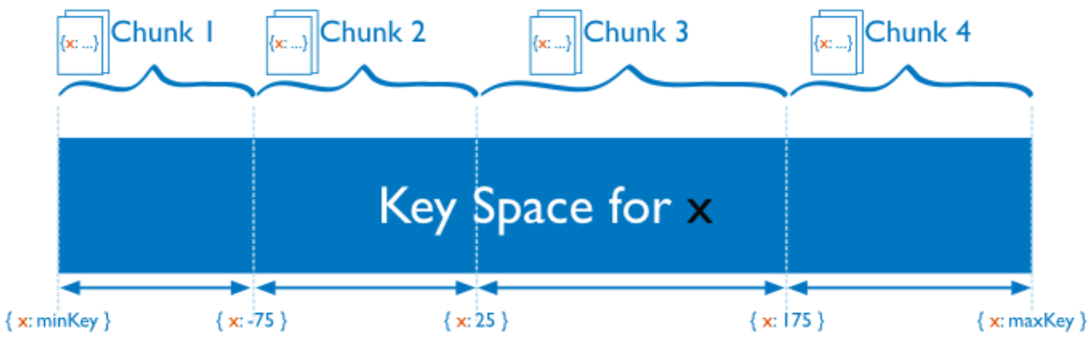
Range-based Sharding

Slide 52
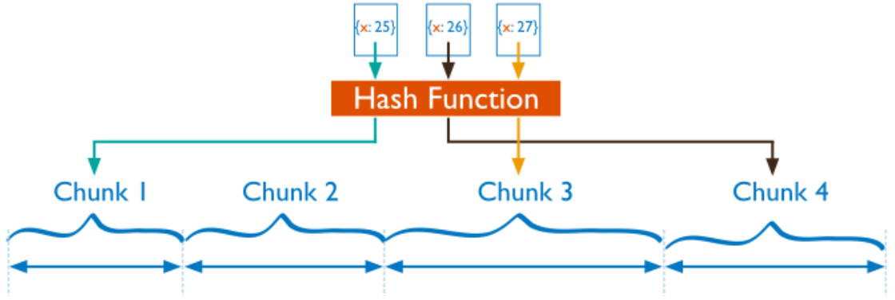
Hash-based Sharding

Slide 53
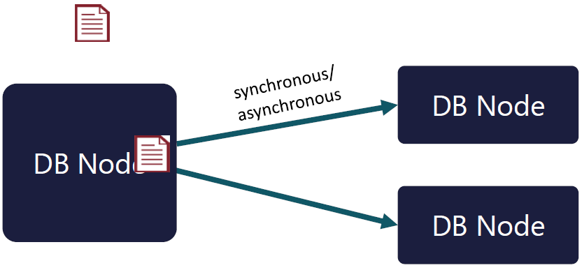
Replication
Replication Read Scalability+ Failure Tolerance
Stores N copies of each data item
Consistency model: synchronous vs asynchronous

Slide 54
Apache Cassandra

Slide 55
Cassandra
Cassandra is a distributed, decentralized, fault tolerant, eventually consistent, linearly scalable, and column-oriented data store
It takes advantage of two proven and closely similar data-store mechanisms, namely Bigtable and Amazon Dynamo

Slide 56




The History of Cassandra
Bigtable
Dynamo

Slide 57



Apache Cassandra
Massively scalable, Open Source, NoSQL, distributed database built for modern, mission-critical online applications
Written in Java and is a hybrid of Amazon Dynamo and Google BigTable
Masterless with no single point of failure
Distributed and data center aware
100% uptime
Predictable scaling
High Performance
Multi Data Center
Time Series
Tunable Consistency
Simple to Operate
    CQL language
Dynamo
BigTable
BigTable: http://research.google.com/archive/bigtable-osdi06.pdf
Dynamo: http://www.allthingsdistributed.com/files/amazon-dynamo-sosp2007.pdf

Slide 59
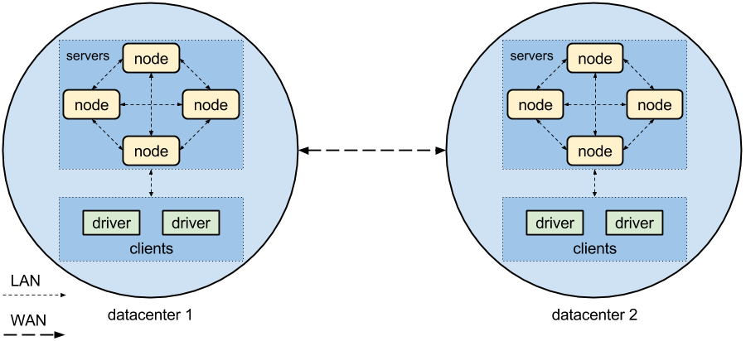
Cassandra Key Structures
Node
Datacenter
Cluster

Slide 60
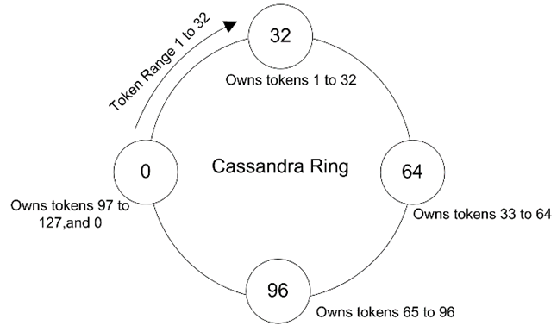
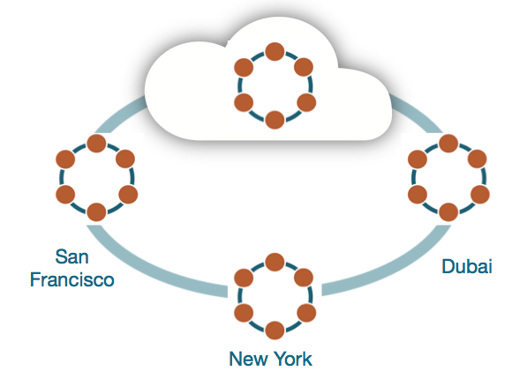
Ring representation
A Cassandra cluster is called a ring

Slide 61
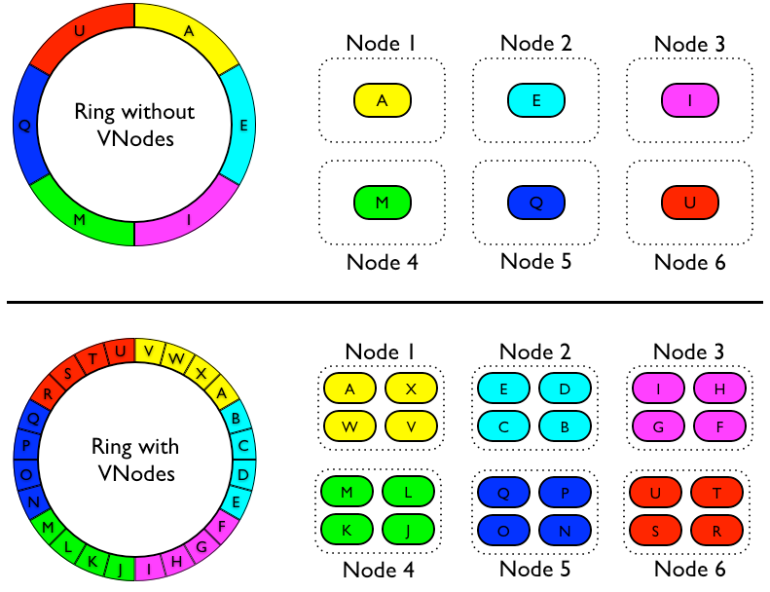
Virtual nodes

Slide 62
Cassandra Data Modeling
Cassandra is not like well known RDBMS systems:
  No a relational model
  No foreign keys, no joins, no aggregations
Denormalization
  Combine columns from different tables in a unique table (“materialized view”), no joins!
  Don’t be afraid to duplicate data, to write data
  Avoid joins at client level!

Slide 63
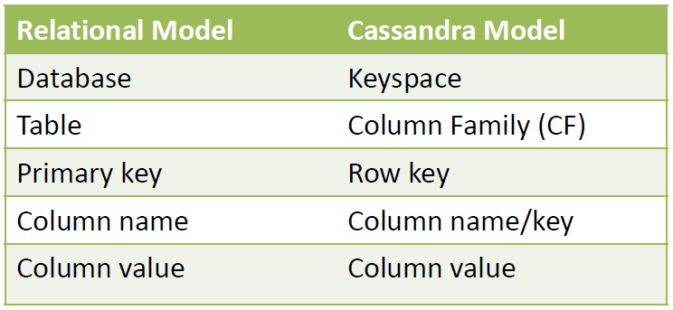
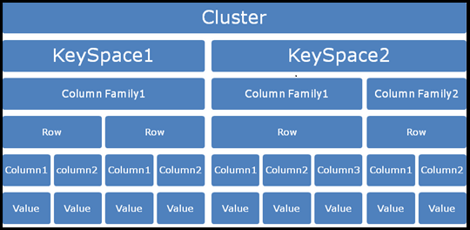
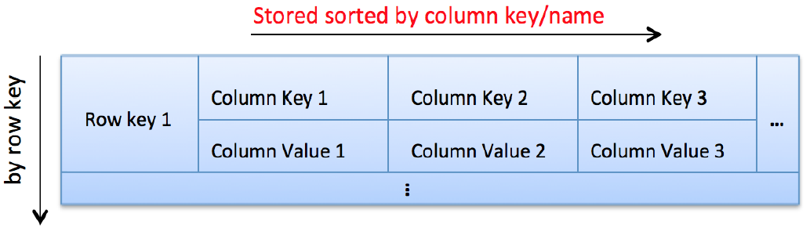
Intro to Cassandra Data Model

Slide 64
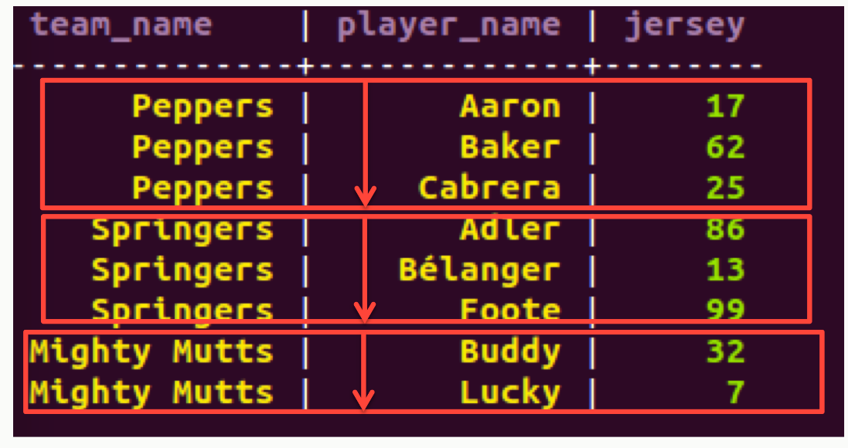
Cassandra Data Model
Based on Google Bigtable
Row-oriented column family
De-normalized
CREATE TABLE sporty_league (
team_name varchar,
player_name varchar,
jersey int,
PRIMARY KEY (team_name, player_name)
);
SELECT * FROM sporty_league;
The primary key uniquely identifies a row.
A composite primary key consists of:
  A partition key
  One or more clustering columns
e.g. PRIMARY KEY (partition key, cluster columns, ...)
The partition key determines on which node the partition resides
Data is ordered in cluster column order within the partition

Slide 65
CQL – Cassandra Query Language
Very similar to RDBMS SQL syntax
Core DML and DDL commands supported: INSERT, UPDATE, DELETE, SELECT, CREATE, GRANT …
INSERT INTO sporty_league (team_name, player_name, jersey) VALUES (’PSG',’Zlatan’,10);
SELECT player_name as nom_joueur FROM sporty_league WHERE team_name = ‘PSG’;
Data type : BLOB, UUID, TIMEUUID, User Defined Type …
User Defined Functions, User Defined Aggregates
Collections : Map, List, Set
TTL (Time-To-Live) at column level
Counters
Batch statements
Secondary Index

Slide 66
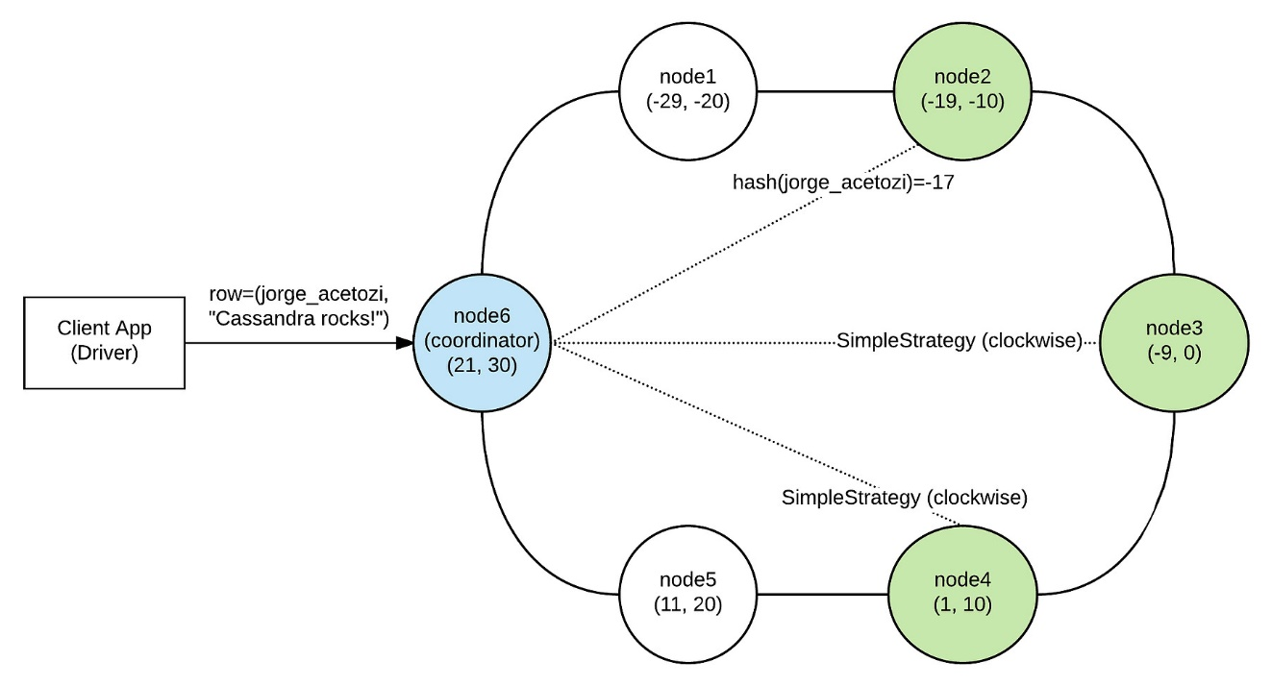
Cassandra Insert Records

Slide 67
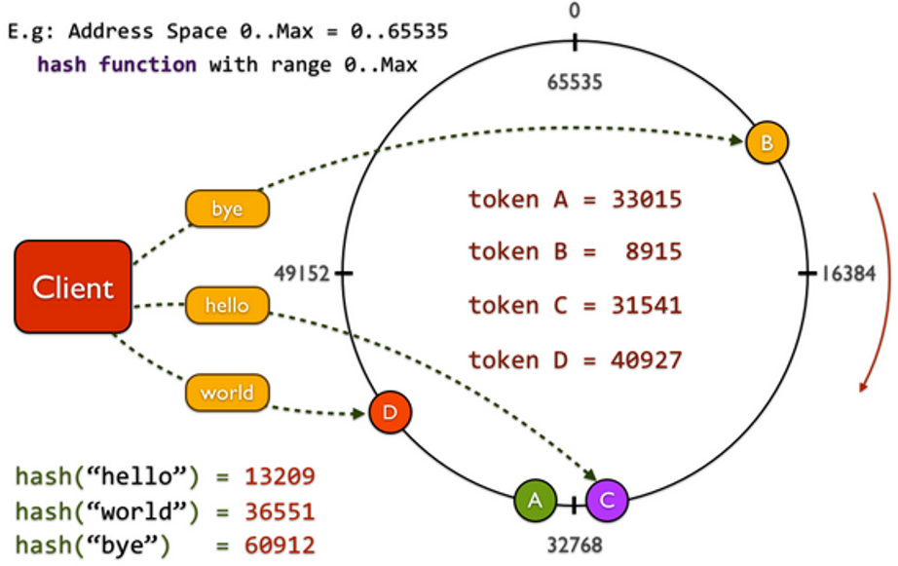
The primary index
Cassandra uses the partitioner (cluster-level setting) and replica placement strategy (keyspace-level setting) to locate the nodes that own a particular row.
Partitioners use a hash function to convert a row key into a unique number (called token) and then read/write happens from the node that owns this token

Slide 68
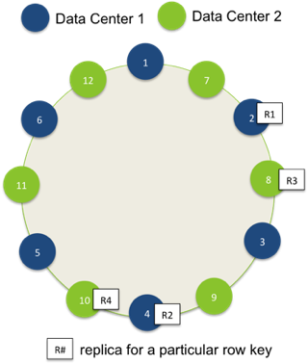
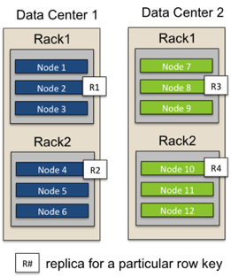
Replication - Network Topology Strategy
RF={DC1:2, DC2:2}

Slide 69
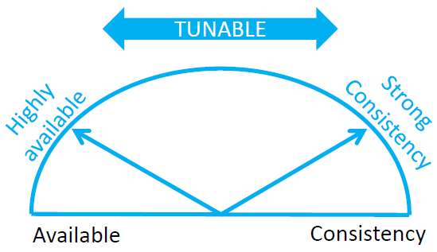
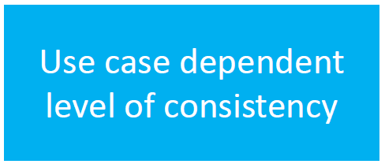
Tunable Consistency
Choose between strong and eventual consistency
Adjustable for read-and write-operations separately
Conflicts are solved during reads, as focus lies on write-performance

Slide 70
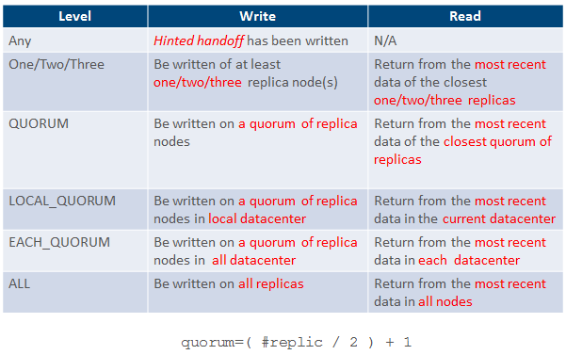
Tunable Consistency

Slide 71
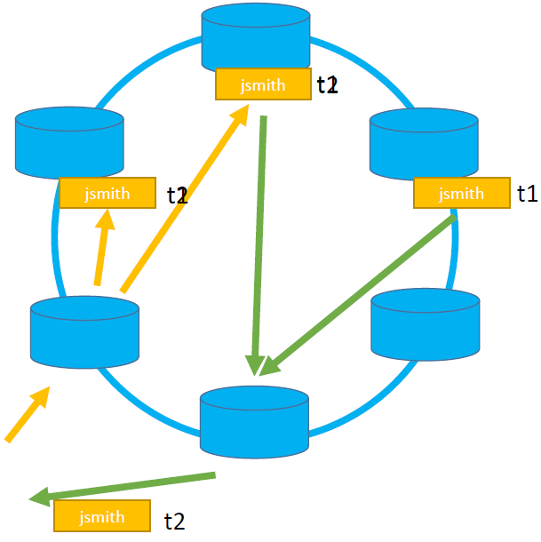
strong consistency
Simple Formula:
  (nodes_written+ nodes_read) >replication_factor
Ensures that a read always reflects the most recent write
  If not: Weak consistency >> Eventually consistent

Slide 72
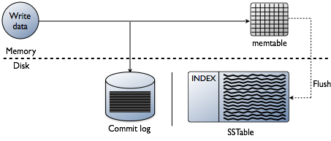
Cassandra Internal Write Records

Slide 73
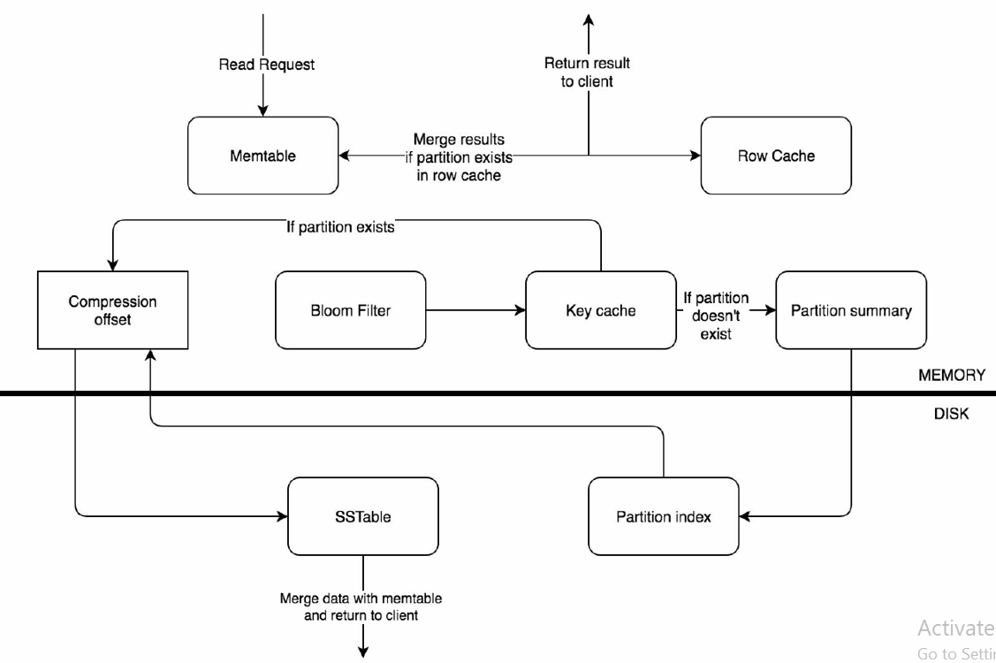
Cassandra Data Read Flow

Slide 74







Slide 75

Apache Spark

Slide 76
Apache Spark
Fast and general purpose cluster computing system
10x (on disk) - 100x (In-Memory) faster
Most popular for running Iterative Machine Learning Algorithms.
Provides high level APIs in
    Java
    Scala
    Python
    R

Slide 77
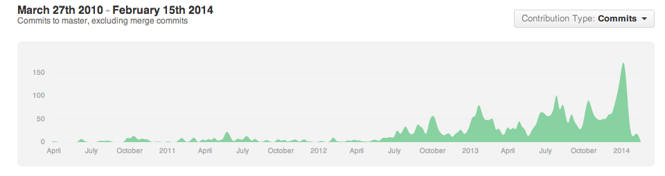



























The Spark Community

Slide 78
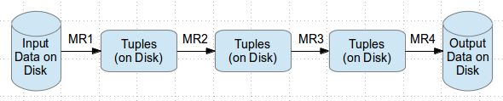
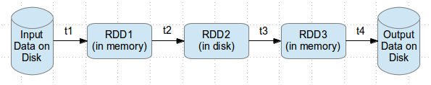
Why Spark ?
Most of Machine Learning Algorithms are iterative because each iteration can improve the results
With Disk based approach each iteration’s output is written to disk making it slow
Hadoop execution flow
Spark execution flow

Slide 79

Spark history

Slide 80
A Brief History: MapReduce
MapReduce use cases showed two major limitations:
  difficultly of programming directly in MR
  performance bottlenecks, or batch not fitting the use cases
In short, MR doesn’t compose well for large applications
Therefore, people built specialized systems as workarounds…

Slide 81

A Brief History: MapReduce

Slide 82
A Brief History: Spark
Unlike the various specialized systems, Spark’s goal was to generalize MapReduce to support new apps within same engine
Some key points about Spark:
  handles batch, interactive, and real-time within a single framework
  native integration with Java, Python, Scala
  programming at a higher level of abstraction
  more general: map/reduce is just one set of supported constructs

Slide 83

Spark Stack
Spark SQL
  For SQL and unstructured data processing
MLib
  Machine Learning Algorithms
GraphX
  Graph Processing
Spark Streaming
  stream processing of live data streams

Slide 84
Benefits of a Unified Platform
No copying or ETL of data between systems
Combine processing types in one program
Code reuse
One system to learn
One system to maintain
Spark is one of the few data processing frameworks that allows you to seamlessly integrate batch and stream processing
  Of petabytes of data
  In the same application

Slide 85
Cluster Deployment
Standalone Deploy Mode
  simplest way to deploy Spark on a private cluster
Amazon EC2
  EC2 scripts are available
  Very quick launching a new cluster
Apache Mesos
Hadoop YARN

Slide 86
SparkContext
First thing that a Spark program does is create a SparkContext object, which tells Spark how to access a cluster
In the shell for either Scala or Python, this is the sc variable, which is created automatically
Other programs must use a constructor to instantiate a new SparkContext
Then in turn SparkContext gets used to create
other variables

Slide 87

Master
The master parameter for a SparkContext determines which cluster to use

Slide 88


RDD
Resilient Distributed Datasets (RDD) are the primary abstraction in Spark – a fault-tolerant collection of elements that can be operated on in parallel

Slide 89

RDD
two types of operations on RDDs:
  transformations and actions
transformations are lazy
  (not computed immediately)
the transformed RDD gets recomputed
  when an action is run on it (default)
however, an RDD can be persisted into
  storage in memory or disk

Slide 90

Transformations
Transformations create a new dataset from an existing one
All transformations in Spark are lazy: they do not compute their results right away – instead they remember the transformations applied to some base dataset
  optimize the required calculations
  recover from lost data partitions

Slide 91

Transformations

Slide 92

Transformations

Slide 93

Action
If an operation on an RDD gives you a result other than an RDD, it is called an action

Slide 94

Actions

Slide 95

Actions

Slide 96
Persistence
Spark can persist (or cache) a dataset in memory across operations
Each node stores in memory any slices of it that it computes and reuses them in other actions on that dataset – often making future actions more than 10x faster
The cache is fault-tolerant: if any partition of an RDD is lost, it will automatically be recomputed using the transformations that originally created it

Slide 97

Execution Flow

Slide 98

Spark SQL
Unified data access with with SchemaRDDs
Tables are a representation of (Schema + Data) = SchemaRDD
Hive Compatibility
Standard Connectivity via ODBC and/or JDBC

Slide 99


Slide 100


Slide 101


Slide 102

Spark Machine Learning
Iterative computation
Vectors, Matrices = RDD[Vector]
Some ML Algorithms
  linear SVM and logistic regression
  classification and regression tree
  k-means clustering
  Recommendation
  linear regression
  feature transformations

Slide 103

Spark GraphX
Unifies graphs with RDDs of edges and vertices
Some GraphX Algorithms
  PageRank
  Connected components
  Label propagation
  SVD++
  Strongly connected components
  Triangle count

Slide 104

Apache Yarn

Slide 105

Apache Mesos

Slide 106

Spark & HDFS

Slide 107


Slide 108

Spark & Mongo

Slide 109


Slide 110

Streaming Data Procssing

Slide 111
Stream Data
Stream data can come from:
  Devices
  Sensors
  Web sites
  Social media feeds
  Applications

Slide 112








Stream Data
Credit Card
& Monetary
Transactions
Healthcare
Retail
Digital
Advertising
& Marketing
Continuously
monitor patient
vital stats and proactively identify
at-risk patients.
Real-time
in-store
Offers and Recommendations.
Email and
marketing campaigns based on real-time social trends
Identify
fraudulent
transactions
as soon as
they occur.
Optimize and personalize digital ads based on real-time information.
Consumer Internet,
Mobile &
E-Commerce
Manufacturing
Security & Surveillance
Transportation
& Logistics
Identify
equipment
failures and
react instantly
Perform proactive
maintenance.
Identify product
quality defects immediately to prevent resource wastage.
Identify
threats
and intrusions,
both digital and physical, in real-time.
Real-time
traffic
conditions
Tracking
fleet and cargo locations and dynamic re-routing to meet SLAs
Optimize user
engagement based
on user’s current
behavior. Deliver recommendations relevant “in the moment”

Slide 113

Real time analysis
Batch processing gives great insights about what happened in the past
  But it lacks the ability to answer the question of what is happening right now
Process events as they arrive (efficiently and at scale)
  Website monitoring
  Network monitoring
  Web clicks
  Advertising
  Internet of things

Slide 114

Apache Spark Streaming

Slide 115

Spark Streaming
Spark streaming receives live input data streams and divides the data into batches (micro-batching)
  Batches are then processed by the spark engine to create the final stream of data
  Can use most RDD transformations
  Also DataFrame/SQL and MLlib operations

Slide 116

DStream
The basic high level abstraction for streaming in spark is called discretized stream or DStream
  represents a continuous stream of data
DStreams can be created
  from input data streams from sources such as Kafka, Flume, and Kinesis
  by applying high-level operations on other DStreams
A DStream is represented as a sequence of RDDs
StreamingContext - the main entry point

Slide 117
StreamingContext
Α StreamingContext object has to be created (batch interval)
  Define the input sources by creating input DStreams
  Define the streaming computations (transformations/output operations) to DStreams
  Start receiving data and processing it (start())
  Wait for the processing to stop (awaitTermination())
  Manually stop using it (stop())

Slide 118
StreamingContext: Remember
Once a context has been started no new computations can be set up
Once a context has been stopped it cannot be restarted
Only one StreamingContext can be active in a JVM at the same time
stop() also stops the SparkContext (set the optional parameter of stop() called stopSparkContext to false)
A SparkContext can be re-used to create multiple StreamingContexts as long as there is only one StreamingContext active

Slide 119

Operations applied on DStream
Operations applied on a DStream are translated to operations on the underlying RDDs
Use Case: Converting a stream of lines to words by applying the operation fatMap on each RDD in the “lines DStream”.

Slide 120

File Streams
Besides sockets, the StreamingContext API provides methods for creating DStreams from files
Reading data from files on any file system compatible with the HDFS API (that is, HDFS, S3, NFS, etc.)
Spark Streaming will monitor a directory and process any files created in that directory

Slide 121
Input DStream and Receivers
Every input DStream except file stream is associated with a Receiver
  Receiver receives data from a source and stores it in spark memory
Two build-in streaming sources
  Basic Sources: Sources directly available in the Streaming Context API (file systems and socket connections)
  Advanced Sources: Kafka, Flume, Kinesis (need more dependencies – check the bitbucket repository given at the end for Kafka example)
Reliable and Unreliable receivers (regarding loss of data due to failure)
  A reliable receiver sends ack to a reliable source when the data has been received and stored in Spark with replication

Slide 122
Check-points
A streaming application must be resilient to failures
Two types of check-points
  Metadata check-pointing
    Store information regarding the streaming computation to HDFS Recovery from failures - configuration, operations, incomplete batches
  Data check-pointing
    Store generated RDDs to HDFS This is necessary in some stateful transformations

Slide 123

Transformations on DStreams
DStreams support most of the RDD transformations
Also introduces special transformations related to state & windows

Slide 124
Stateless vs Stateful Operations
By design streaming operators are stateless
  they know nothing about any previous batches
Stateful operations have a dependency on previous batches of data
  continuously accumulate metadata overtime
  data check-pointing is used for saving the generated RDDs to a reliable stage

Slide 125
DStreams transformations
DStreams transformations
map(func) | Return a new DStream by passing each element of the source DStream through a function func.
flatMap(func) | Similar to map, but each input item can be mapped to 0 or more output items.
filter(func) | Return a new DStream by selecting only the records of the source DStream on which func returns true.
repartition(numPartitions) | Changes the level of parallelism in this DStream by creating more or fewer partitions.
union(otherStream) | Return a new DStream that contains the union of the elements in the source DStream and otherDStream.
count() | Return a new DStream of single-element RDDs by counting the number of elements in each RDD of the source DStream.
reduce(func) | Return a new DStream of single-element RDDs by aggregating the elements in each RDD of the source DStream using a function func (which takes two arguments and returns one). The function should be associative and commutative so that it can be computed in parallel.
countByValue() | When called on a DStream of elements of type K, return a new DStream of (K, Long) pairs where the value of each key is its frequency in each RDD of the source DStream.

Slide 126
DStreams transformations (cont.)
DStreams transformations (cont.)
reduceByKey(func,[numTasks]) | When called on a DStream of (K, V) pairs, return a new DStream of (K, V) pairs where the values for each key are aggregated using the given reduce function. Note: By default, this uses Spark's default number of parallel tasks (2 for local mode, and in cluster mode the number is determined by the config property spark.default.parallelism) to do the grouping. You can pass an optional numTasks argument to set a different number of tasks.
join(otherStream, [numTask]) | When called on two DStreams of (K, V) and (K, W) pairs, return a new DStream of (K, (V, W)) pairs with all pairs of elements for each key.
cogroup(otherStream, [numTask]) | When called on a DStream of (K, V) and (K, W) pairs, return a new DStream of (K, Seq[V], Seq[W]) tuples.
transform(func) | Return a new DStream by applying a RDD-to-RDD function to every RDD of the source DStream. This can be used to do arbitrary RDD operations on the DStream.
updateStateByKey(func) | Return a new "state" DStream where the state for each key is updated by applying the given function on the previous state of the key and the new values for the key. This can be used to maintain arbitrary state data for each key.

Slide 127

Spark Streaming

Slide 128

Apache Storm

Slide 129
Apache Storm
Distributed, real-time computational framework, used to process unbounded streams.
It enables the integration with messaging and persistence frameworks.
It consumes the streams of data from different data sources.
It process and transform the streams in different ways.

Slide 130
Apache Storm Concepts
Topology
Storm topology represents a graph of computations using:
Nodes
  Represents individual computations
Edges
  Represents data being passes between Nodes
Topology is driven through the continuous live feed of data and perform some operation.

Slide 131
Topology
Node
Edge
Node
Edge
Node

Slide 132
Apache Storm Concepts
Tuple
  Data send between nodes in form of Tuples.
Stream
  Unbounded sequence of Tuples between two Nodes.
Spout
  Source of Stream in Topology.
Bolt
  Computational Node, accept input stream and perform computations.

Slide 133
Topology
Spout
Stream
Bolt
Stream
Bolt
Live feed of data
Messaging
System

Slide 134
Apache Storm Concepts
Spout
  Receive data by
    Listen to message queue for incoming messages
    Listen to database changes
    Listen to other source of data feed
  Act as a source of stream
  Read data from data source
  Emit tuple to next type of node called Bolt.

Slide 135
Apache Storm Concepts
Bolt
  Accept tuple from its input stream
  Perform computation/transformation
  Perform filtering, aggregation or perhaps join
  Emit new tuple to its output stream

Slide 136
Storm Grouping
define how data is exchanged between nodes in topology
use when bolt has several paralele instance (several tasks)
Shuffle
  Tuple emitted by the source to a randomly chosen bolt instance
  bolt warranting that each bolt instance will receive the same number of tuples
Fields
  Controls how tuples are sent to bolt instances with fields in tuple
  Tuple with same field value will be sent into same bolt instance

Slide 137
Storm Grouping
Partial Key
  Controls how tuples are sent to bolt instances with field s in tuple
  load balanced between two downstream bolts instance, which provides better utilization of resources
  use when the incoming data is skewed
All
  Replicate and sends a each tuple to all instances of the receiving bolt
Custom
  create your own custom stream grouping
Global Grouping
  all instances of the source send tuples to a single target iinstance
  For example the lowest id

Slide 138
Storm Grouping
Local or shuffle grouping
  If the target bolt has one or more instances (tasks) in the same worker process, tuples will be shuffled to just those in-process tasks
  Will act like a normal shuffle grouping if that isn’t case
Direct grouping
  producer of the tuple decides which bolt instanceof the consumer will receive this tuple.
  It must be specified the task ID, task ID can be gotten from OutputCollector

Slide 139

Storm Word Count Topology

Slide 140

Storm Word Count Topology

Slide 141

Storm Architecture

Slide 142





Canonical Stream Processing Architecture
Data
Sources
Notes:
Lets look at an end to end architecture of putting together open source tools to do real time stream processing.
Lets start with the sources of data.

Slide 143



Canonical Stream Processing Architecture
Data
Sources
Kafka
Flume
Notes:
You want to write this data to a reliable high-throughput low latency messaging system, Kafka and Flume are popular choices, but there are many options out there, like ActiveMQ, RabbitMQ,etc.
Kafka is the system that is gaining the most popularity right now.
======
With this architecture, the real-time processed data only gets leveraged when the next application query comes in. But often you want to take some action based on the real-time analysis of your data.
For proactive actions, write relevant events out to Kafka. Again, based on yoru stream processign engine you will find libraries that make this easy.
You can have an application that is continusouly listeing on your event queue, and can issues alerts, emails, etc

Slide 144

Canonical Stream Processing Architecture
Filter
Enrich
Transform
Stats on Sliding Windows
Stream Joins
Feature Engineering
Predictive Analytics
Active Model Training
.
.
.
.
And combinations of the above
Data
Sources
Kafka
Flume
Notes:
A stream processing system like Spark Streaming can then read your data streams from the messaging system.
Filter
Enrich or embellish your data with relevant metadata
Transform
Compute statistics based on moving windows of time
Feature Engineering + Predictive Analytics
… and much more

Slide 145
Canonical Stream Processing Architecture
Data
Sources
HDFS
Kafka
Flume
Notes:
Almost always, you want to take your full fidelity raw data, and put it in HDFS, or an object store if your are running in the cloud.
The raw data can then be used in batch jobs where you may want to do deep complex processing that can not be done in a streaming fashion. Or you may have a team of data scientists who may want to explore the data and uncover new insights.
Why the dotted line: how you dump your data to HDFS depends on your messaging system. Almost all messaging systems will provide a way to transfer your data to HDFS

Slide 146



Canonical Stream Processing Architecture
Data
Sources
HDFS
NoSql
Kafka
Flume
Notes:
All this real-time processing is great, but not very useful if you can not serve the processed data to your application in real-time. Your need a system that can enable a lot of fast reads and writes. That is where NoSql stores come in. There are many choices here. Hbase, Cassnadra and MongoDb are popular choices.
All those end applications
Also, for most stream procsssing engine and NoSql store pairs, there are libraries available that make it easy to read from or write to your NoSql store from the stream processing engine: for example, the SparkOnHbase library makes it easy to write to Hbase from spark streamign jobs.

Slide 147


Canonical Stream Processing Architecture
Data
Sources
HDFS
NoSql
Kafka
Flume
Notes:
Another common scenario is indexing your data, in real-time, into a search system.
This is great if the data your are dealing with is textual data.
There are libararies that enable real-time indexing of your data in your stream proocessing engine, and writing it to a Search Engine.

Slide 148


Canonical Stream Processing Architecture
Data
Sources
HDFS
NoSql
Kafka
Flume
Notes:
Now the data is ready to be queried by your application.
This is a very common and popular architecture, and I am guessing this is in keeping with what most of you would have expected.

Slide 149
Canonical Stream Processing Architecture
Data
Sources
HDFS
NoSql
Kafka
Flume
Notes:
Again, write your processed output to HDFS. Again, why the dotter arrow. Weather or not you need to dump data to HDFS depends upon your serving system of choice. If you write it to Hbase, you may not need to duplicate it in HDFS. But if you are indexing the data in search or writing to a system like Redis, you may want to also write the processed otuptut to HDFS. Why? If nothing else, for auditing purposes. Errors will happen. And you may need to go back and audit what was done in your stream processing engine. Hence, put the data in hdfs and keep it there are some amount of time.

Slide 150

Canonical Stream Processing Architecture
Data
Sources
HDFS
NoSql
Kafka
Flume
Kafka
Notes:
With this architecture, the real-time processed data only gets leveraged when the next application query comes in. But often you want to take some action based on the real-time analysis of your data.
For proactive actions, write relevant events out to Kafka. Again, based on yoru stream processign engine you will find libraries that make this easy.
You can have an application that is continusouly listeing on your event queue, and can issues alerts, emails, etc

Slide 151
Canonical Stream Processing Architecture
Data
Sources
HDFS
NoSql
Kafka
Flume
Kafka
.
.
.
Notes:
By writing it to a message queue, you enable multiple downstream applications to consume the data as its produced, including enabling furthur processing of your data with a stream processing engine. Such multi-stage architectures, where you cosnume from say Kafka, process the data, produce a new stream in Kafka, and process

Slide 152

VahidAmiry.ir
@vahidamiry

